Slide 1
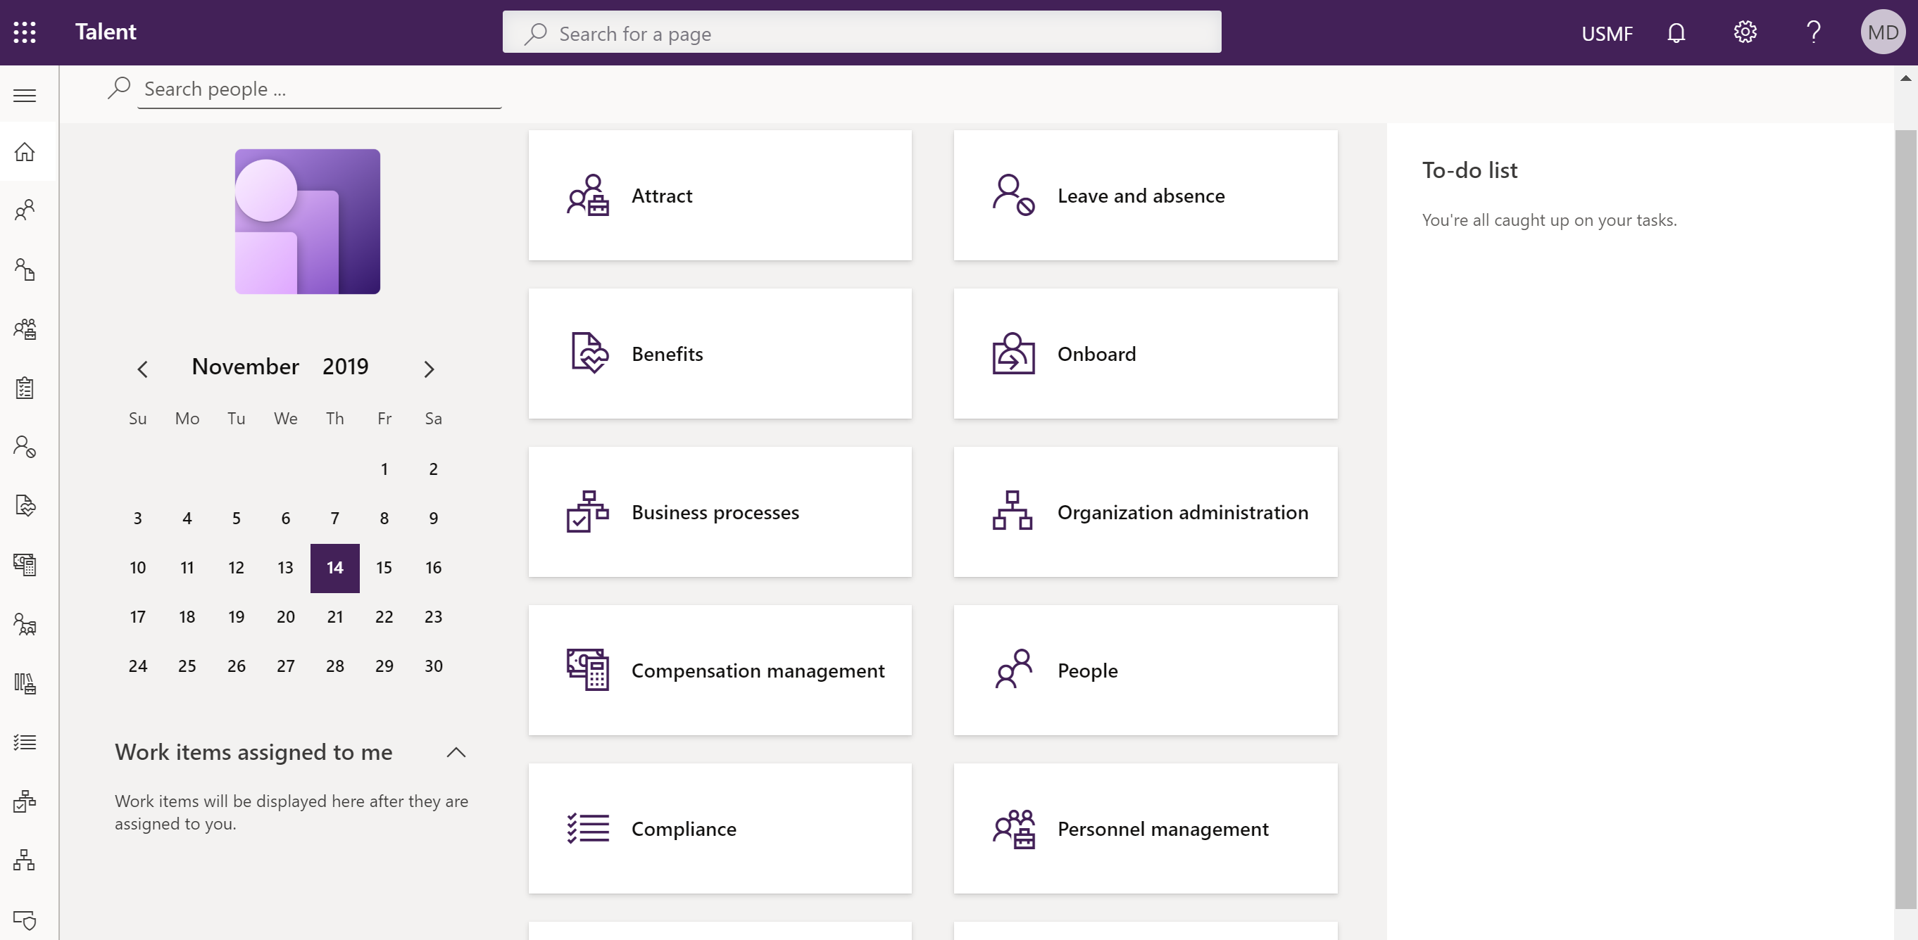
Hvordan Talent kan digitalisere en glemt HR avdeling
Malin Donoso Martnes

Slide 2
Om meg
Utdanning innen markedsføring
Bruker i Dynamics CRM fra 2009
Konsulent i Dynamics CRM fra 2014
Talent fra Mars 2018
Blogget hver arbeidsdag i 6 måneder
Driver den Norske gruppen Women in Dynamics
Første og eneste MVP med fokus på Talent

Slide 3
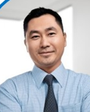
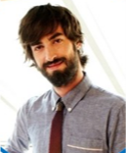
Core HR
Employee
HR
Manager

Slide 4
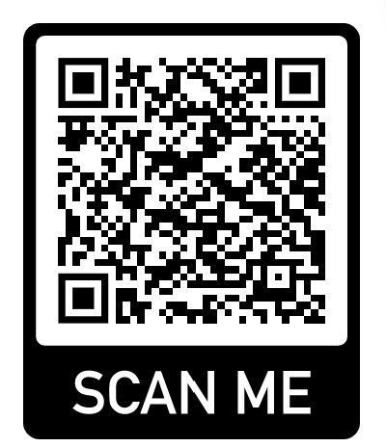
Common Data Service (CDS)
https://docs.microsoft.com/en-us/dynamics365/unified-operations/talent/corehrentities
Ikke alle entiteter er på CDS (enda)

Slide 6
Person, position and hierarchy

Slide 7
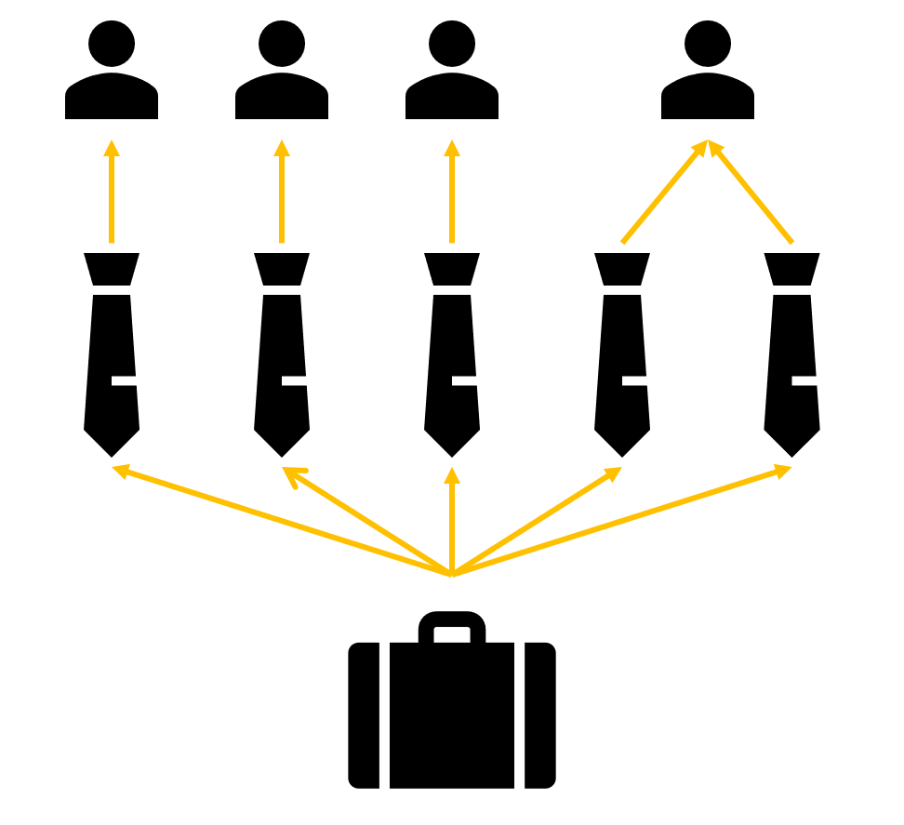
Employee
Position
Job
Notes:
Right click – view details – go directly to the page you need to fill inn information

Slide 8
HR
Notes:
Right click – view details – go directly to the page you need to fill inn information

Slide 9
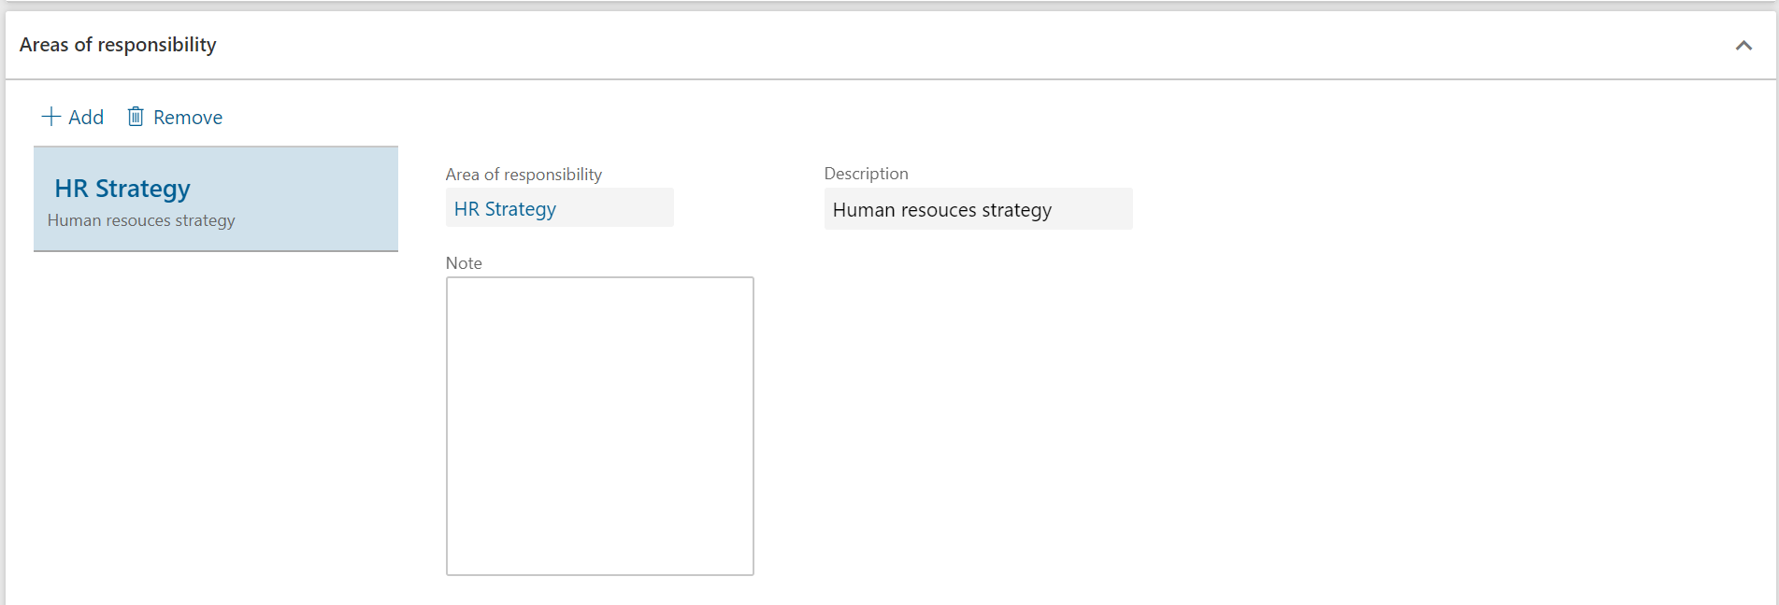
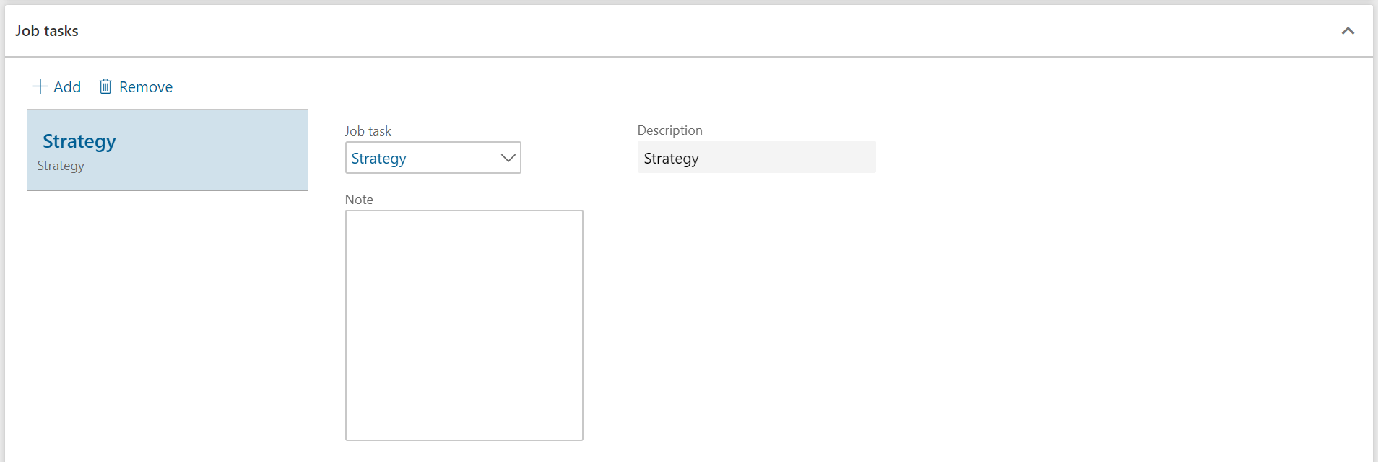
HR
Notes:
Right click – view details – go directly to the page you need to fill inn information

Slide 10
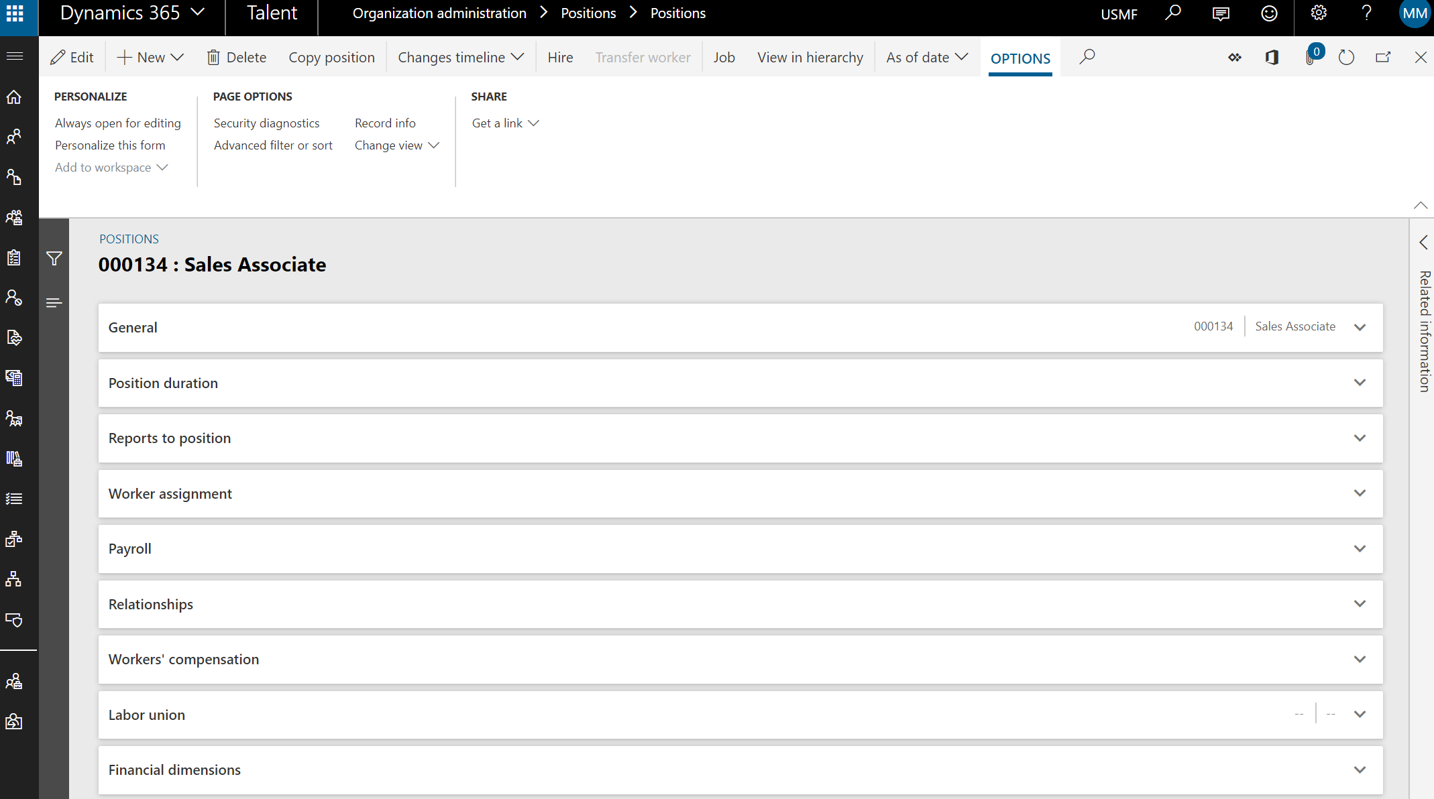
HR

Slide 11
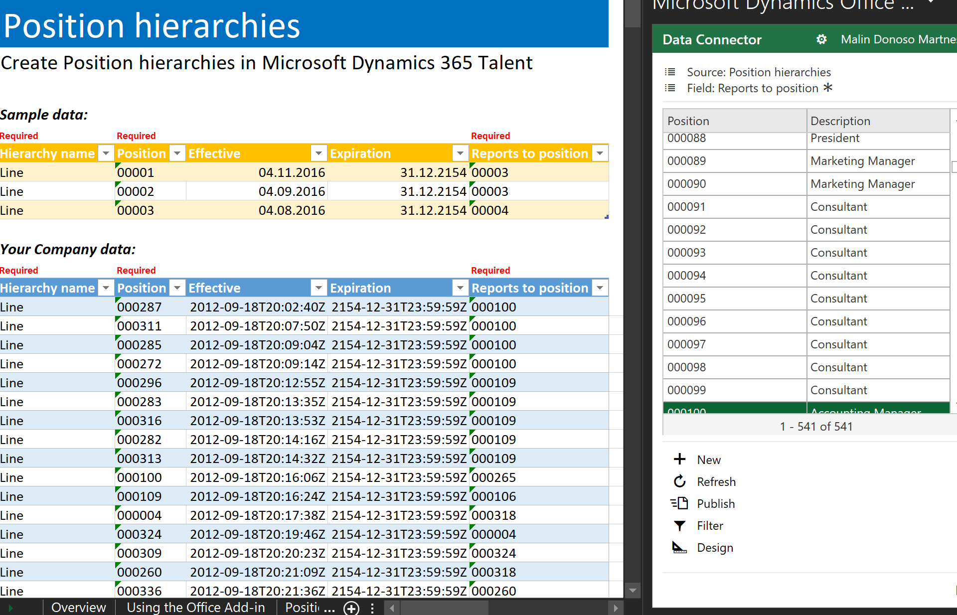
HR

Slide 12
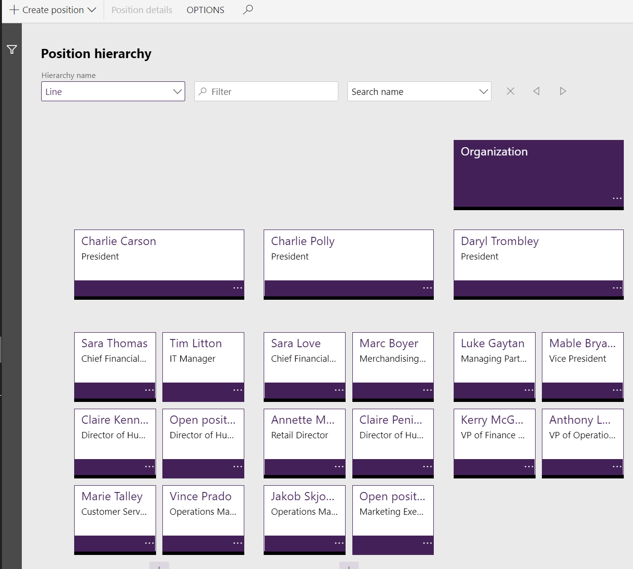
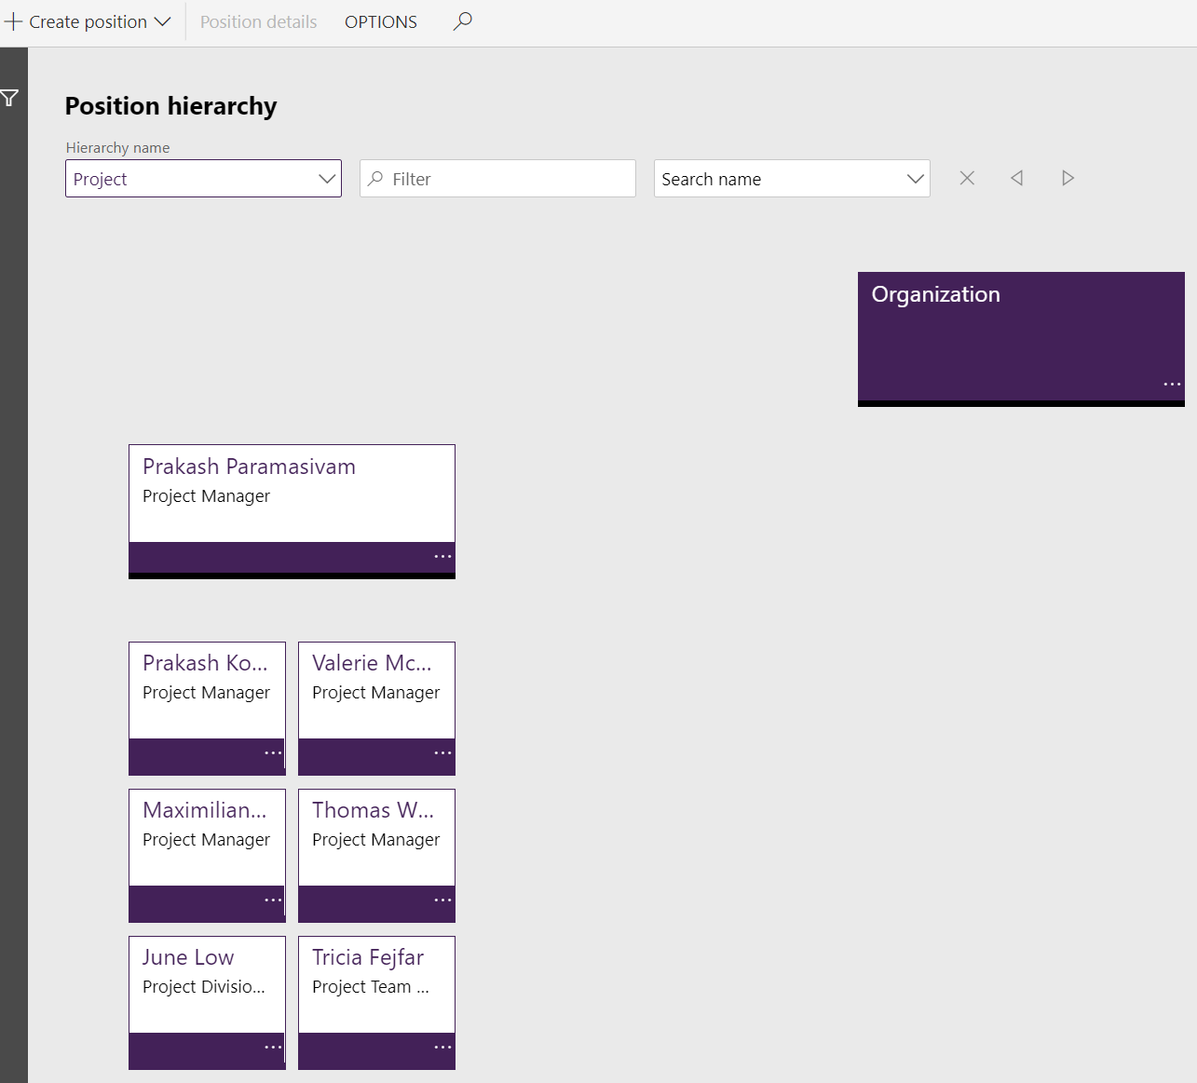
HR

Slide 13
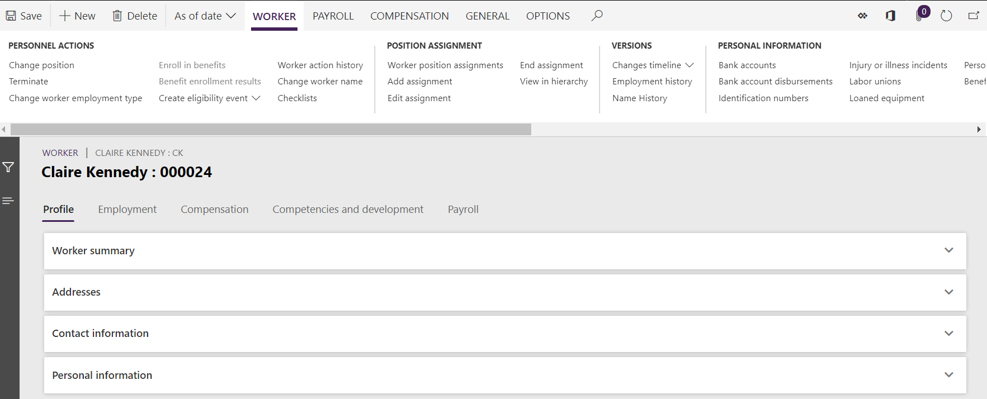
HR

Slide 14
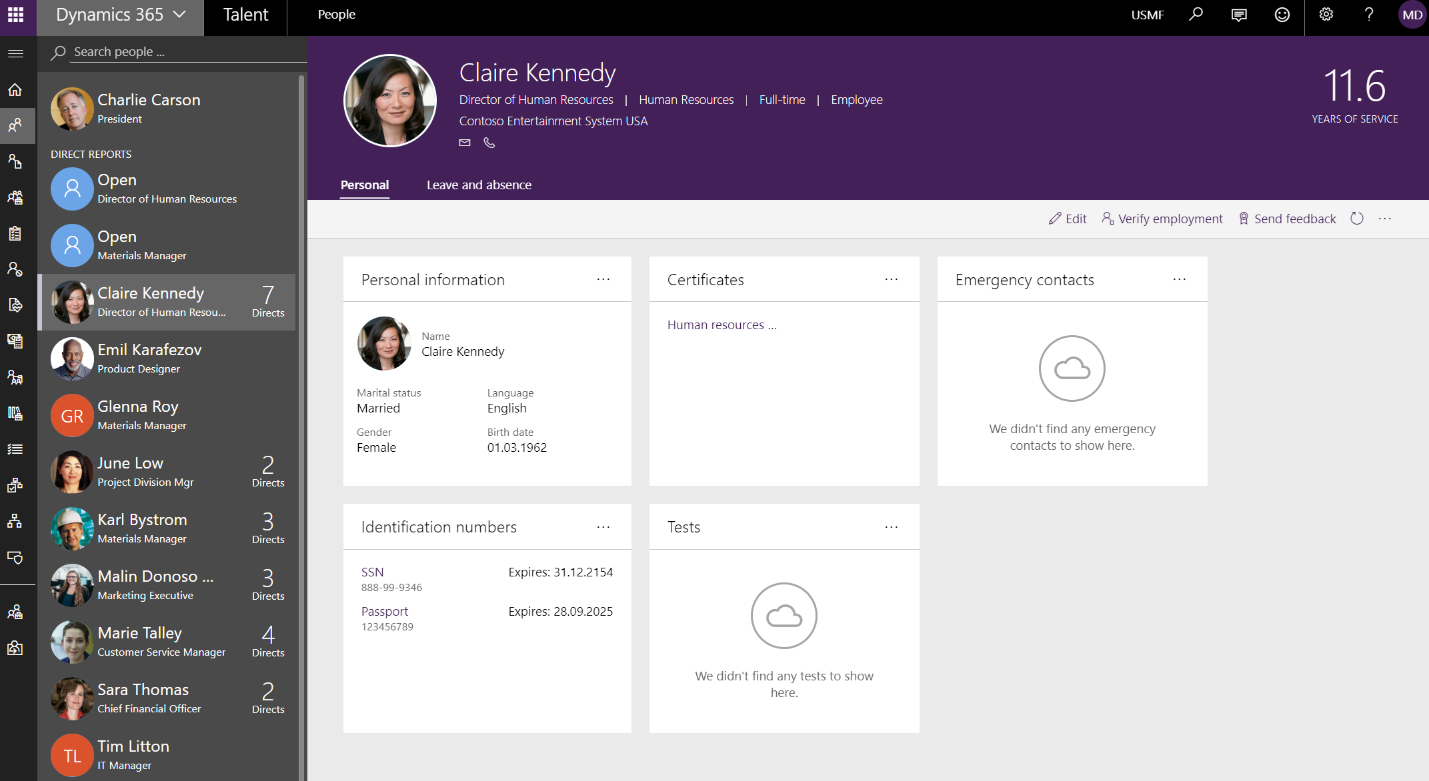
HR

Slide 15
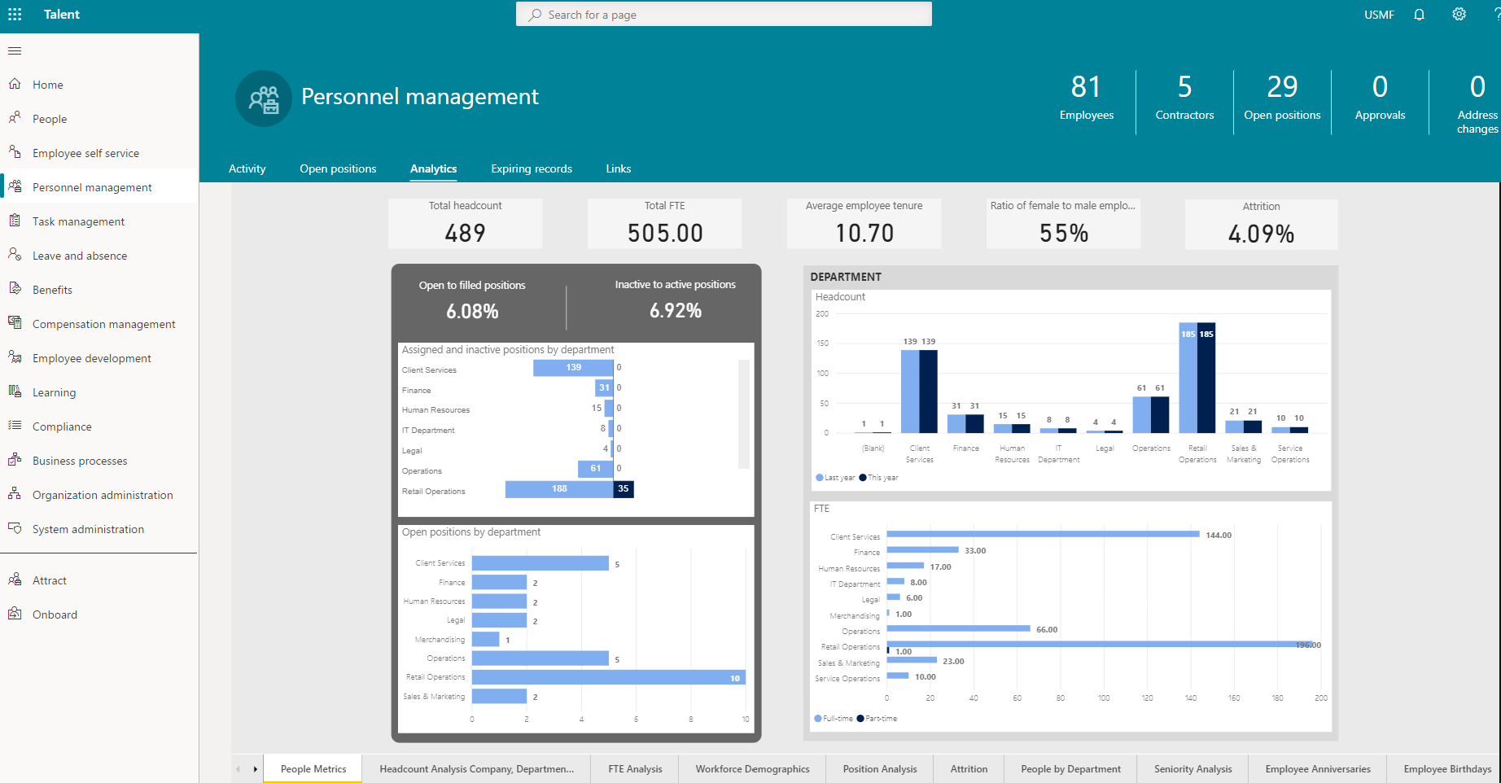
HR

Slide 16
Onboarding, transition og Offboarding

Slide 17
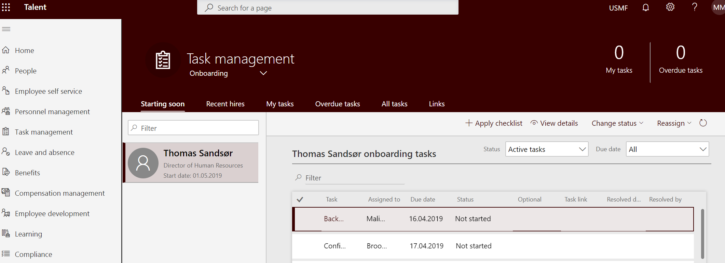
HR
Manager
Employee

Slide 18
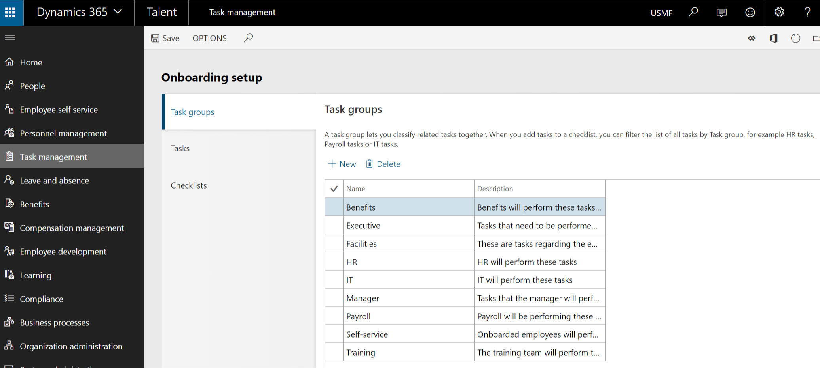
HR

Slide 19
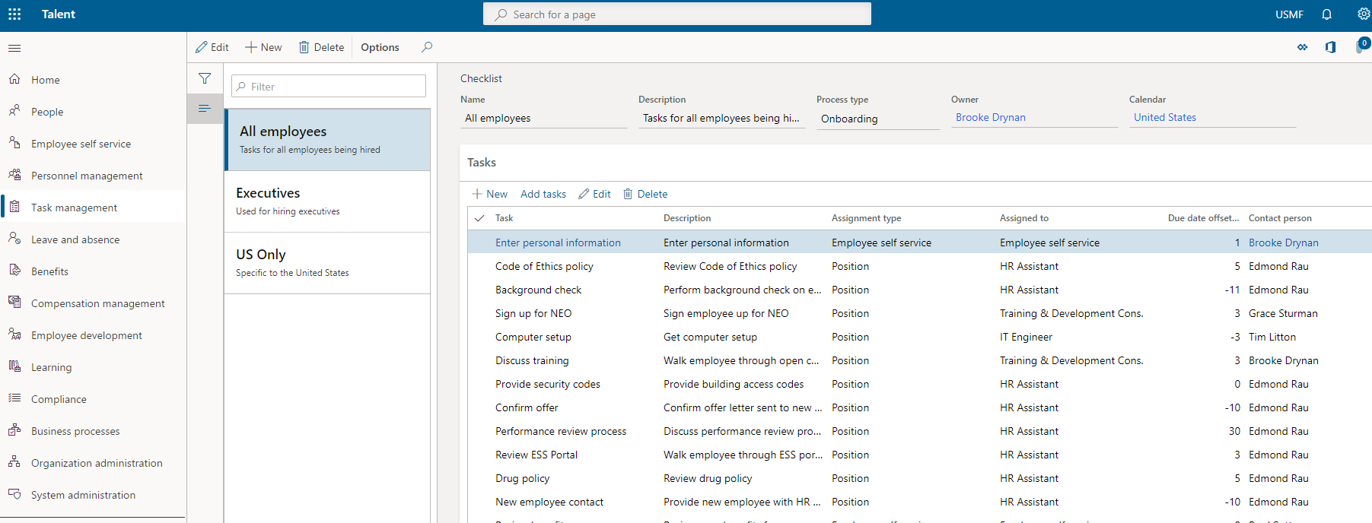
HR

Slide 20
Selvbetjening
Manager
Employee

Slide 21
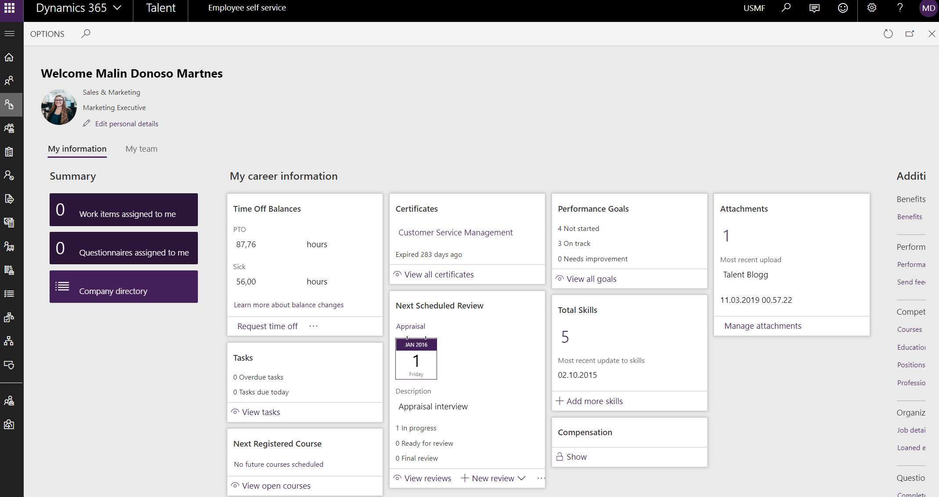
Employee

Slide 22
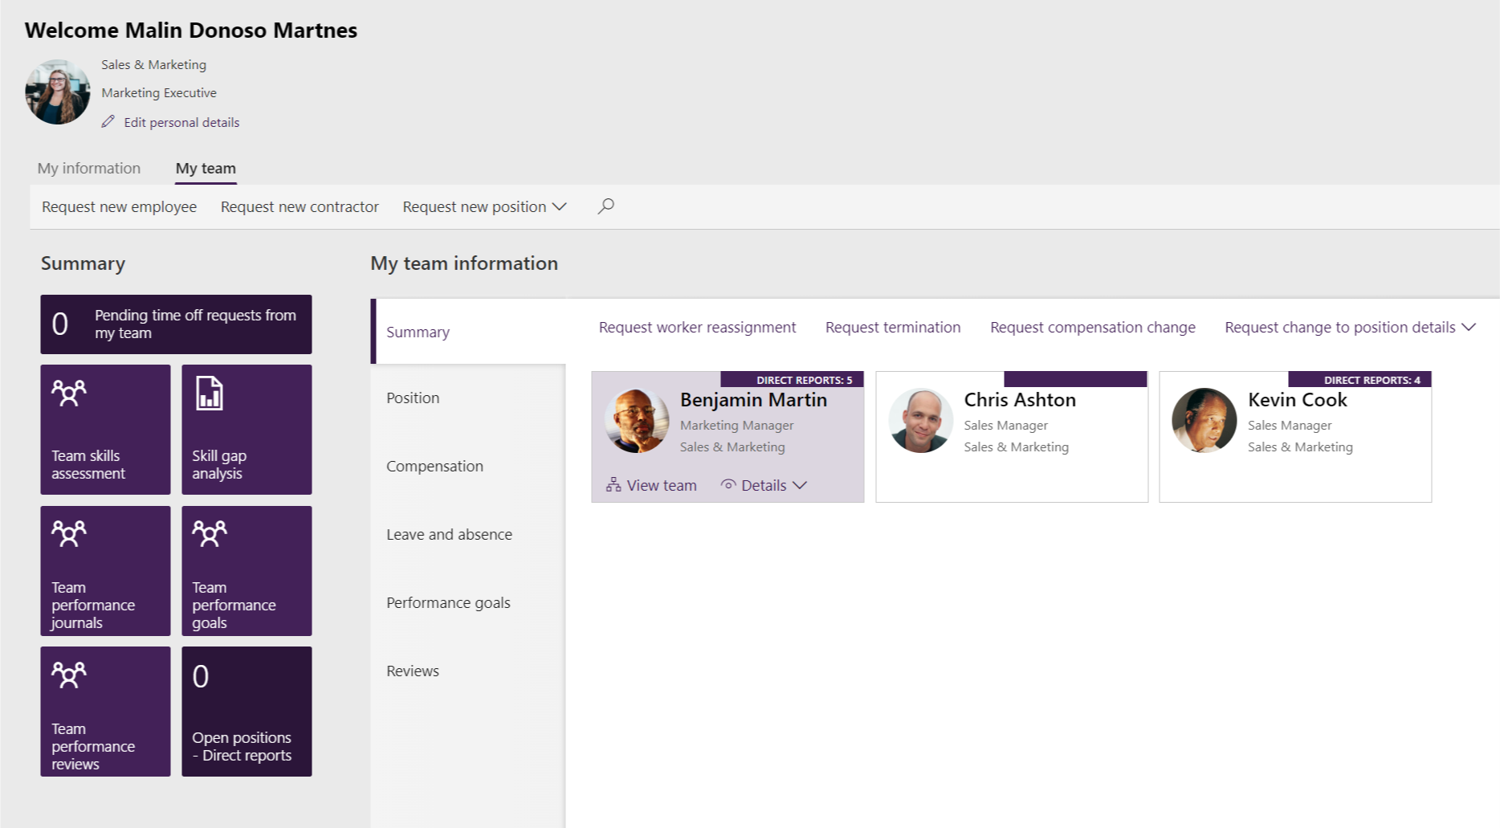
Manager

Slide 23
Personlig utvikling og lønnsjustering

Slide 24
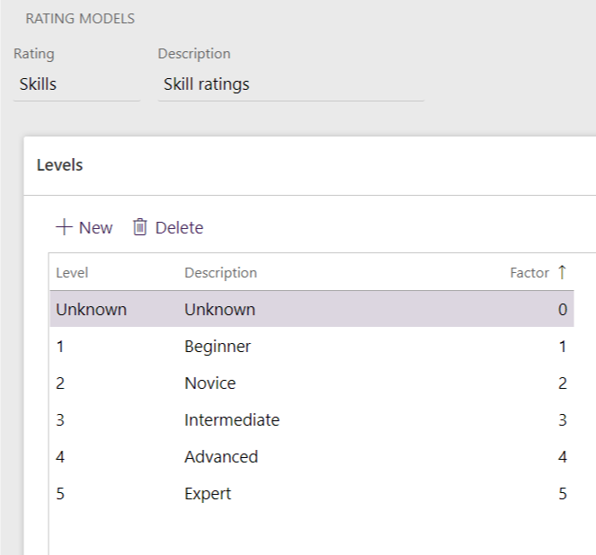
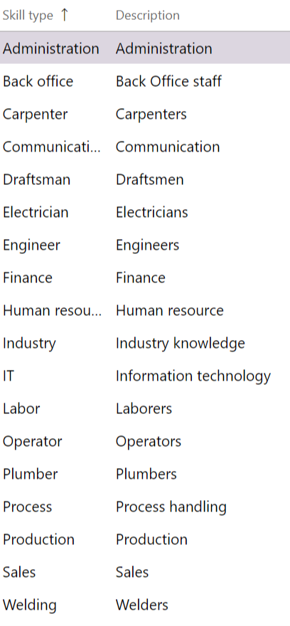
HR

Slide 25
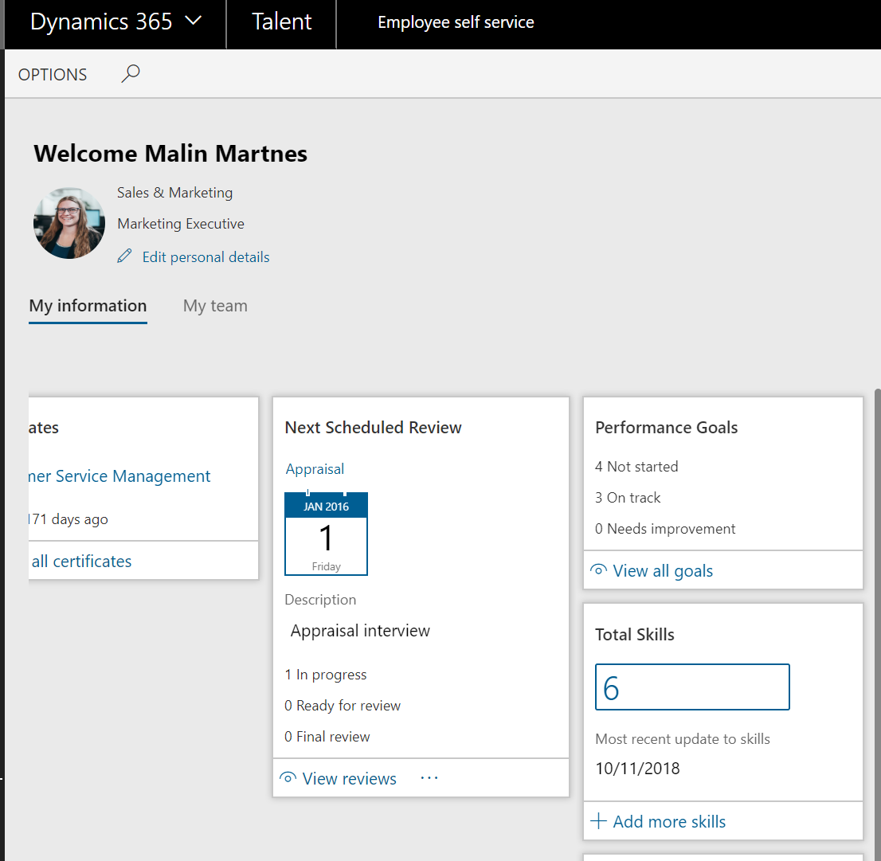
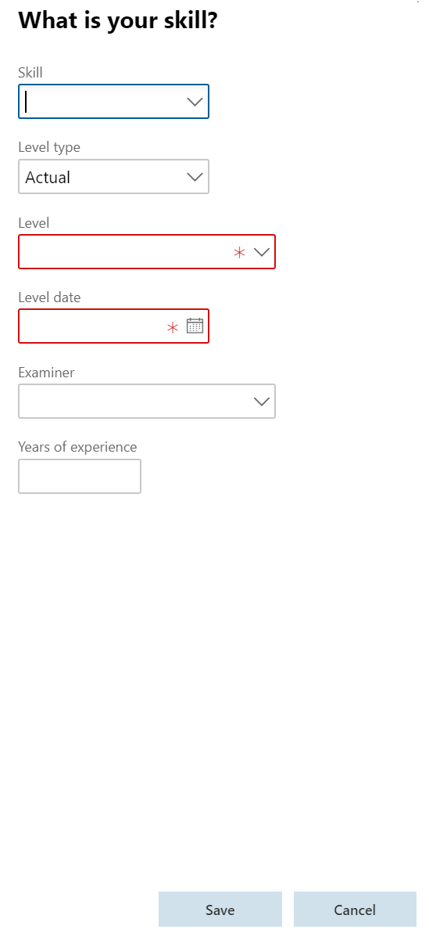
Employee

Slide 26
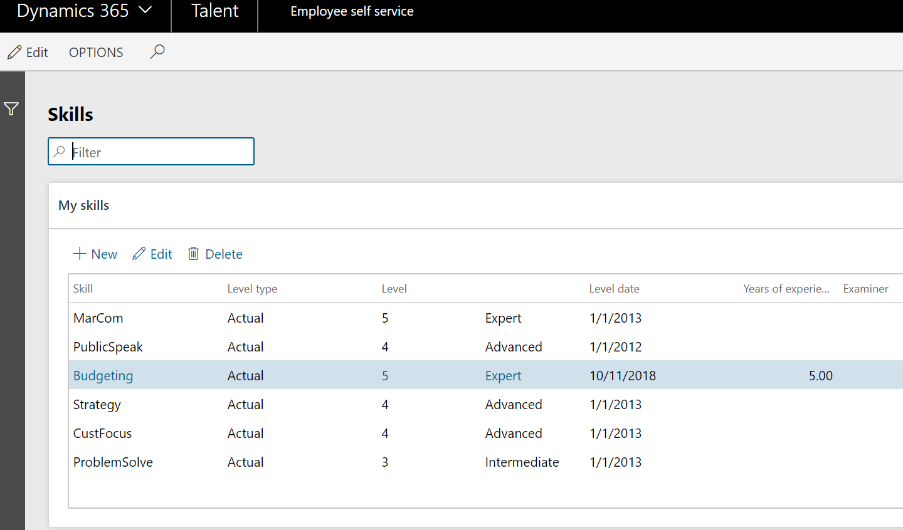
Employee

Slide 27
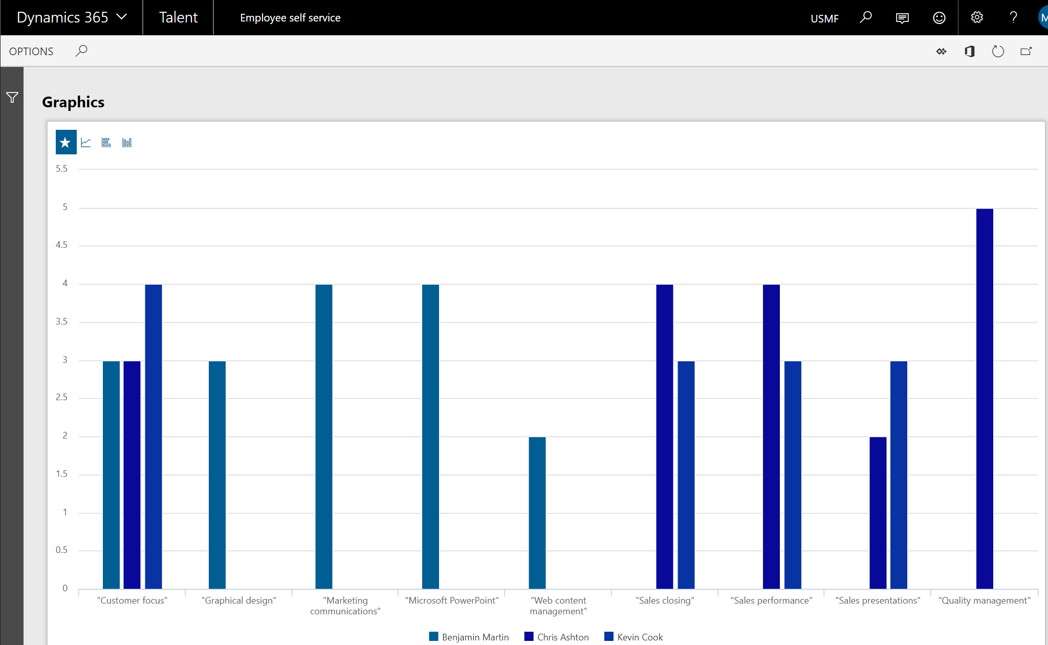
Manager

Slide 28
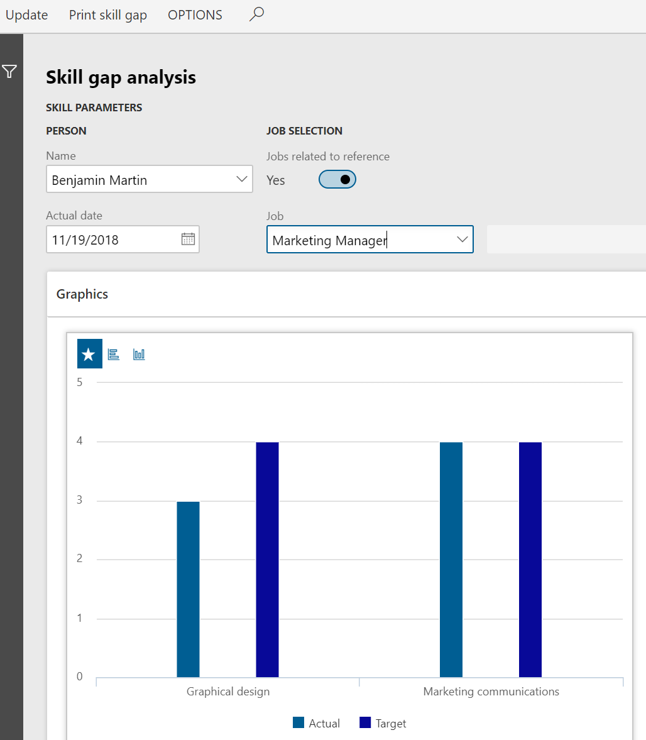
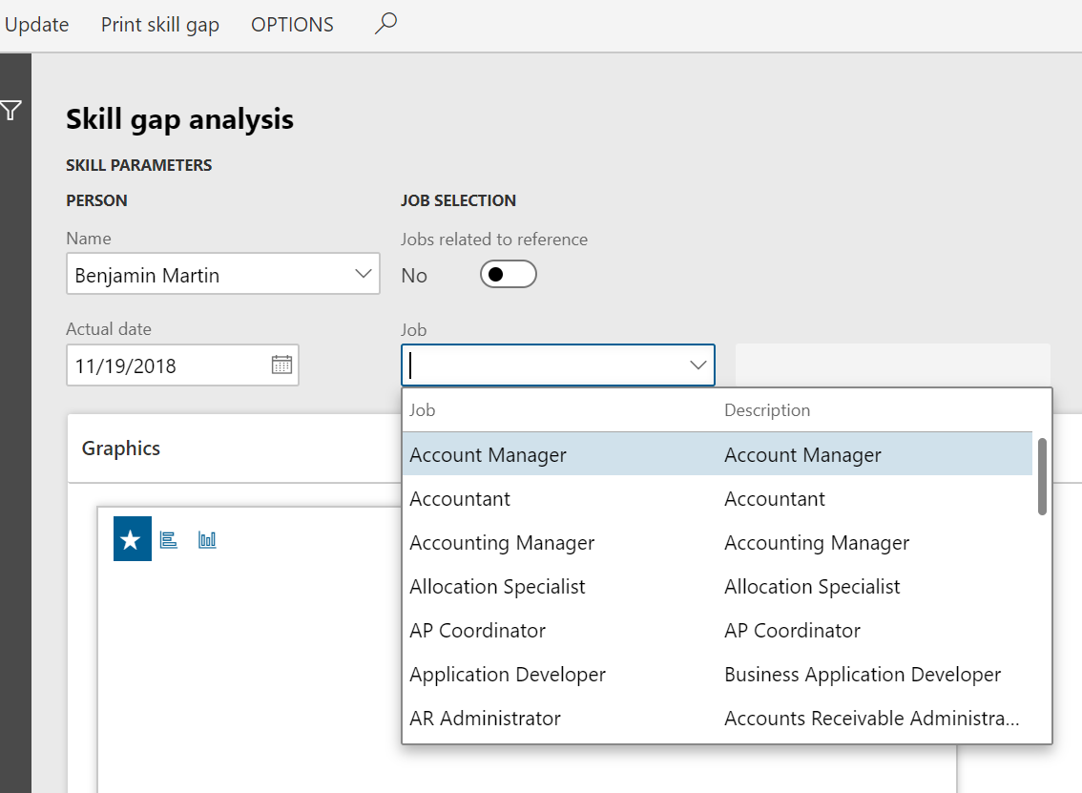
Manager

Slide 29
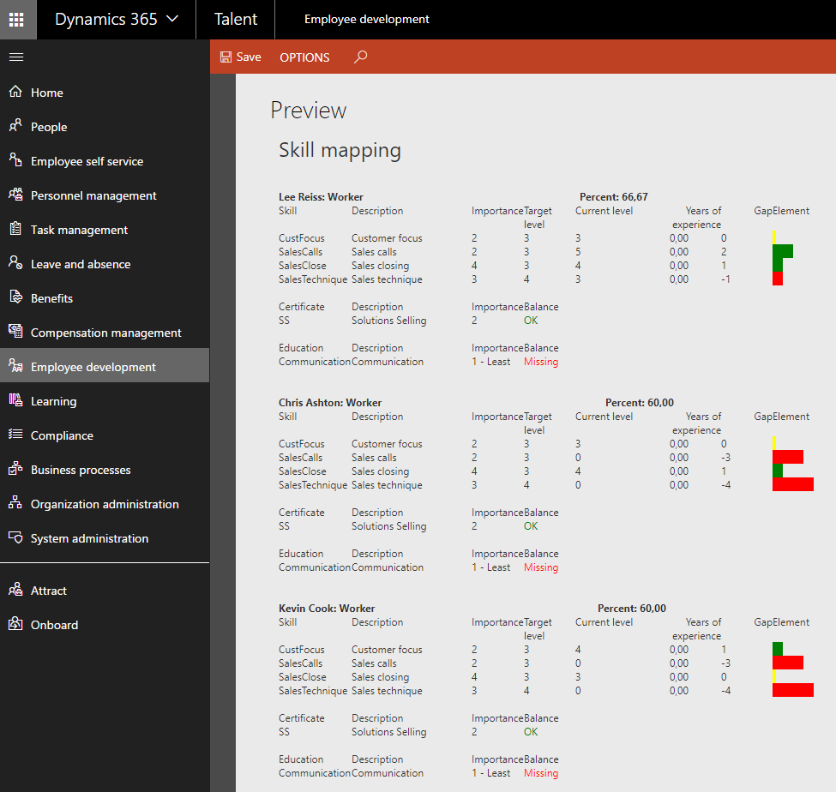
HR
Manager

Slide 30
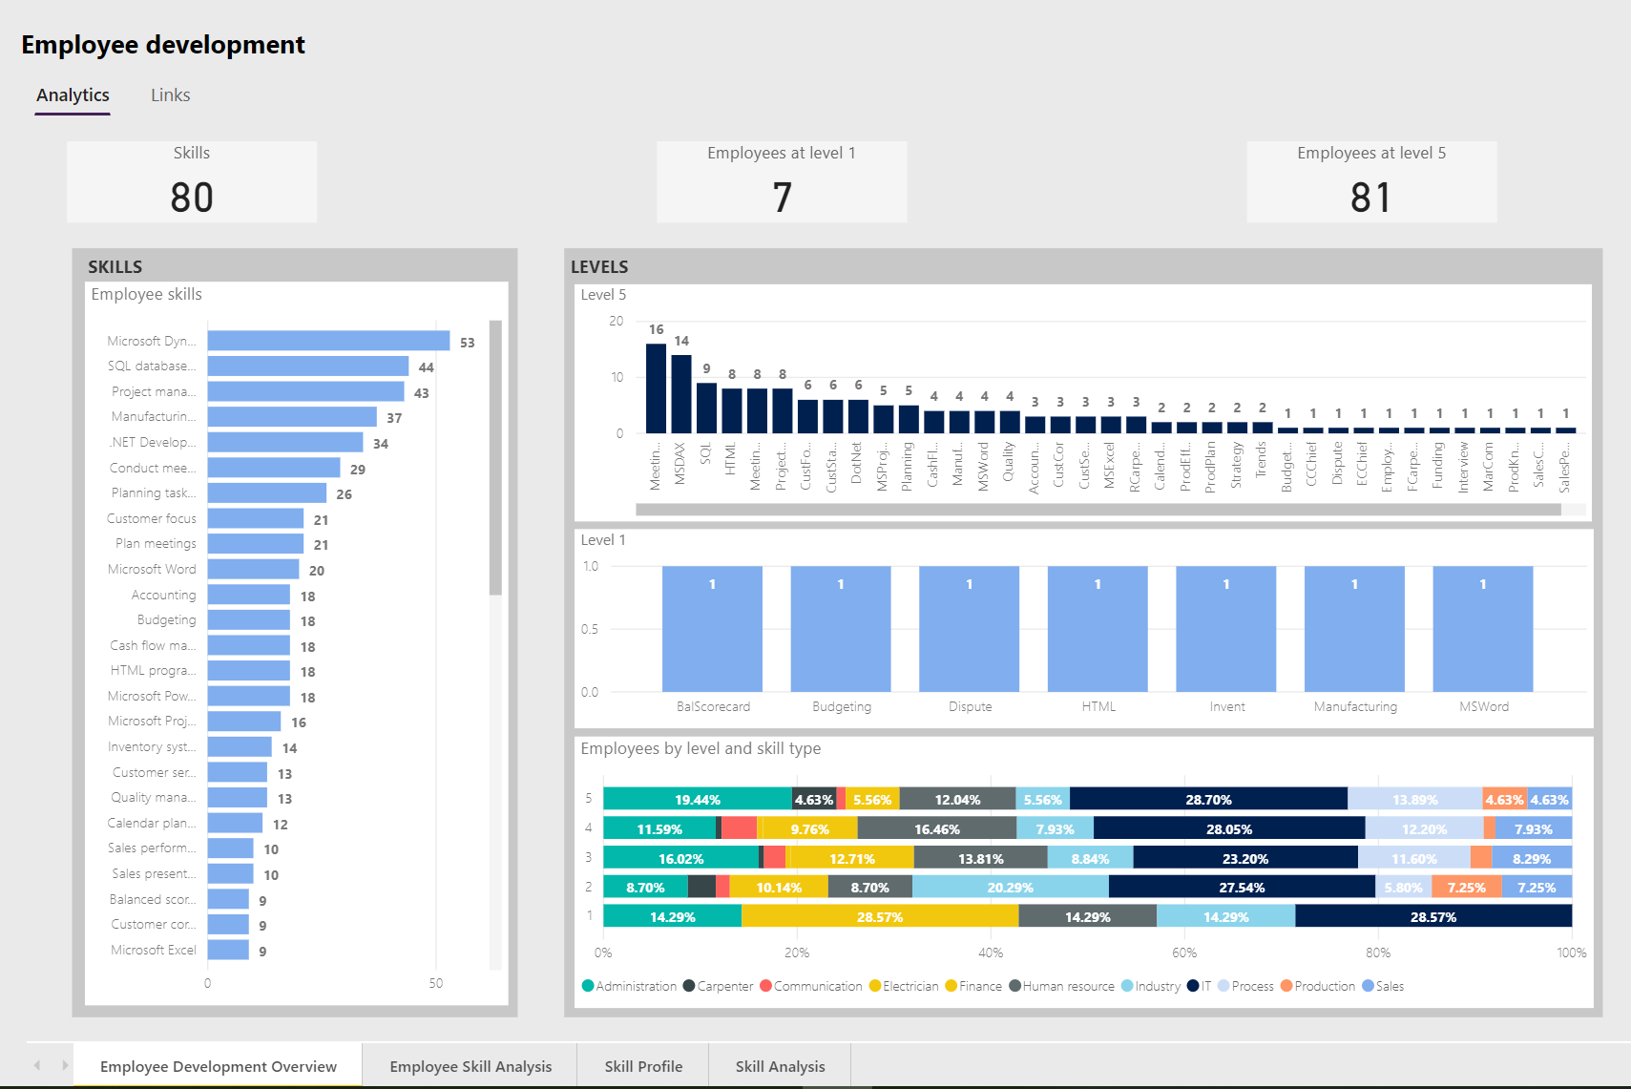
HR

Slide 31
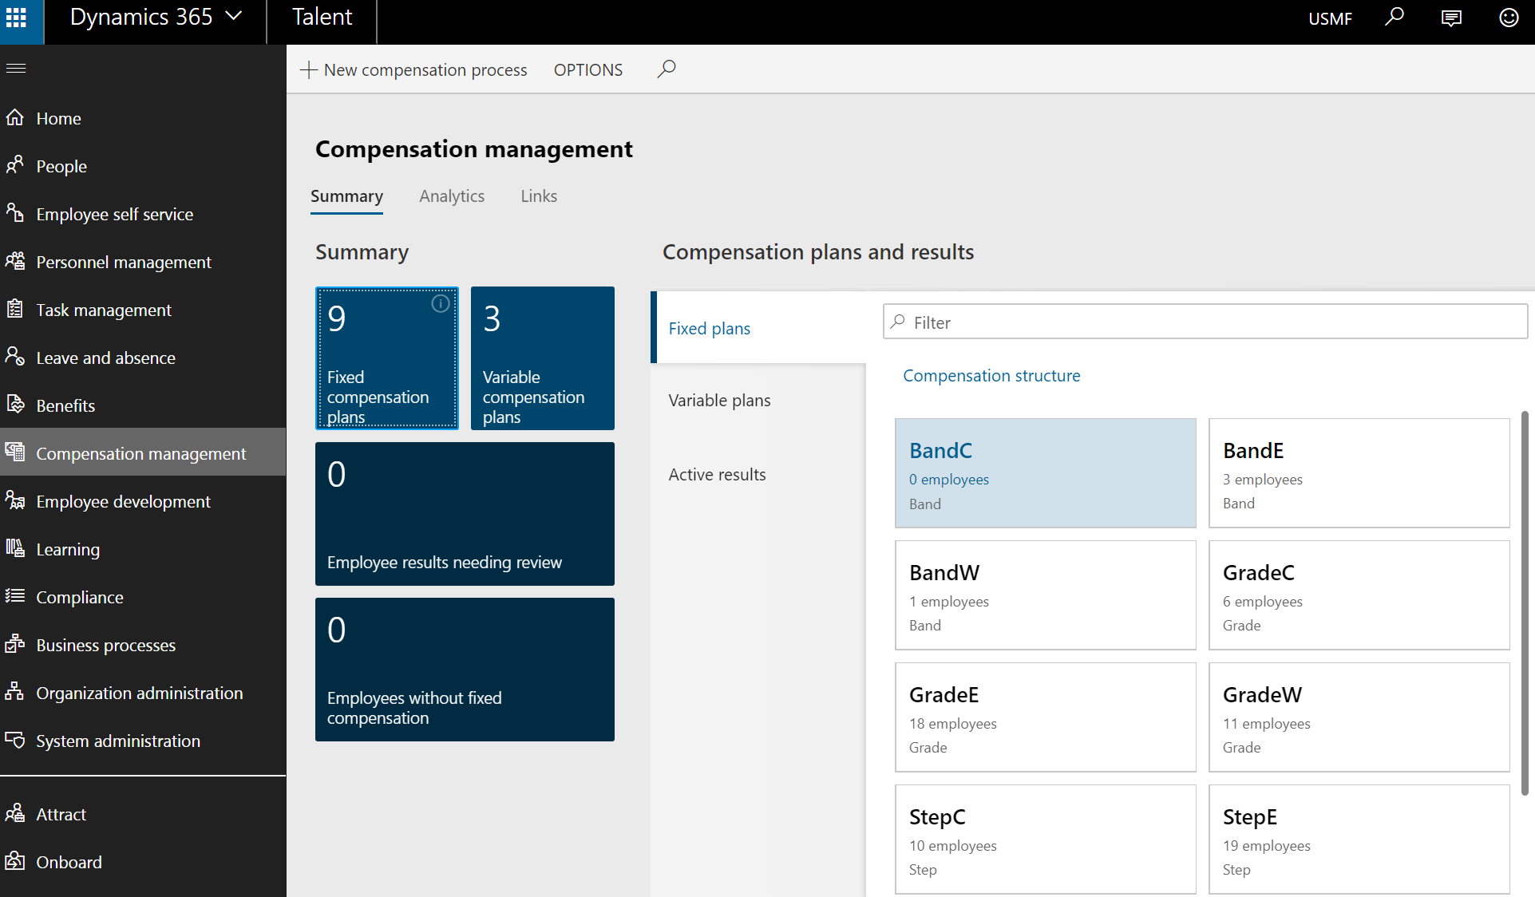
HR
Manager

Slide 32
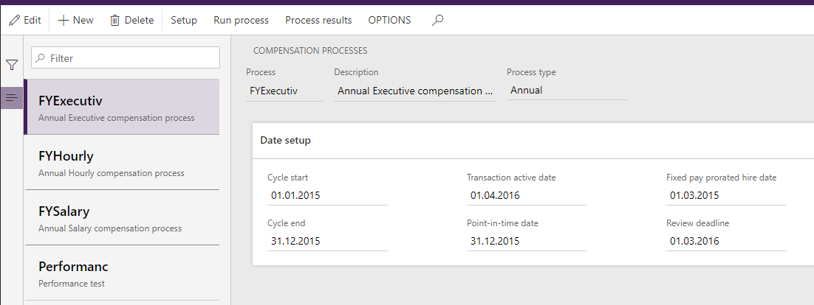
HR
Manager

Slide 33
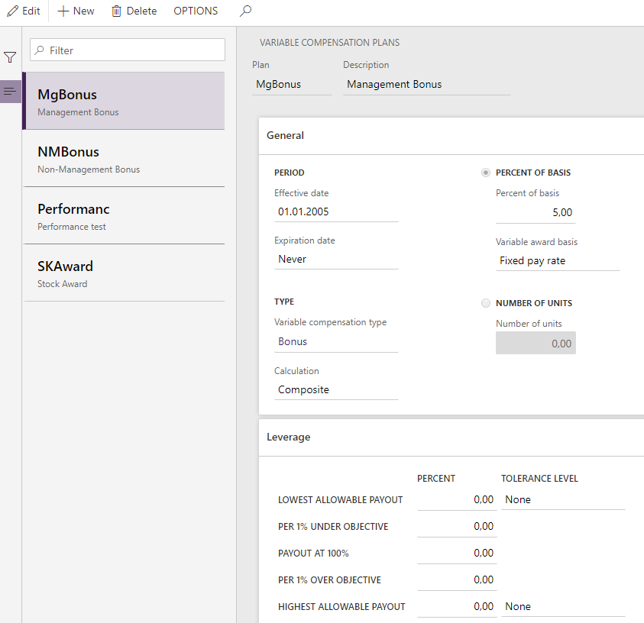
HR
Manager

Slide 34
HR
Manager

Slide 35
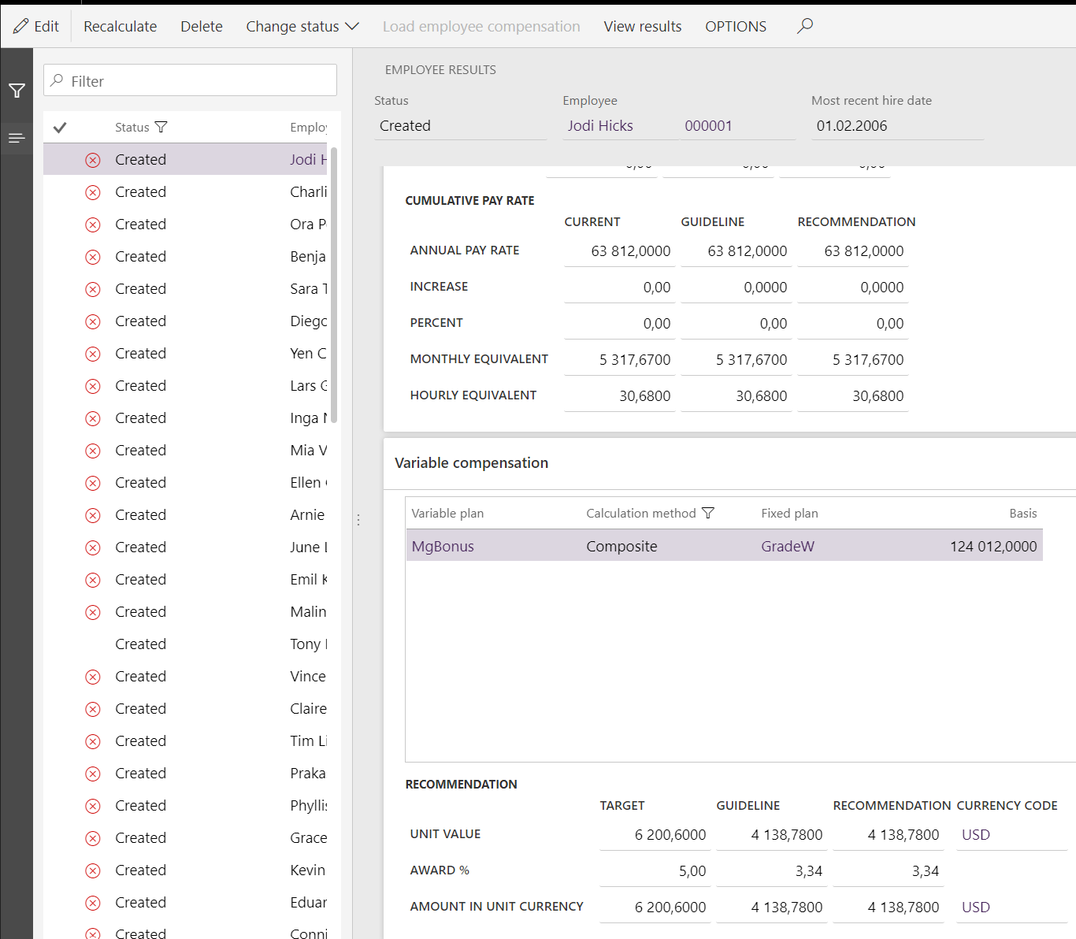
HR
Manager

Slide 36
HR
Manager

Slide 37
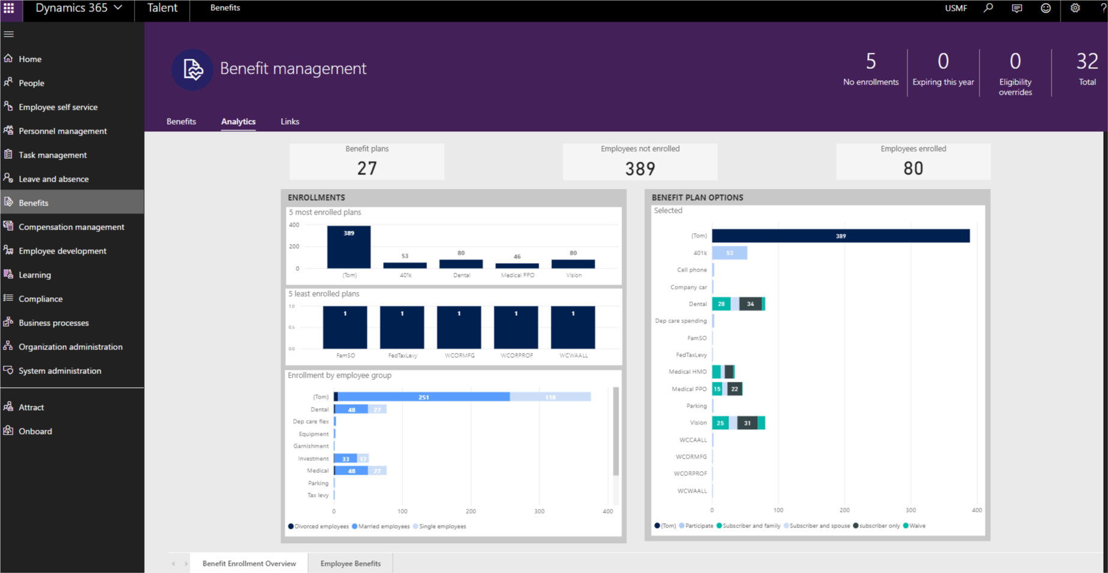
HR
Manager

Slide 38
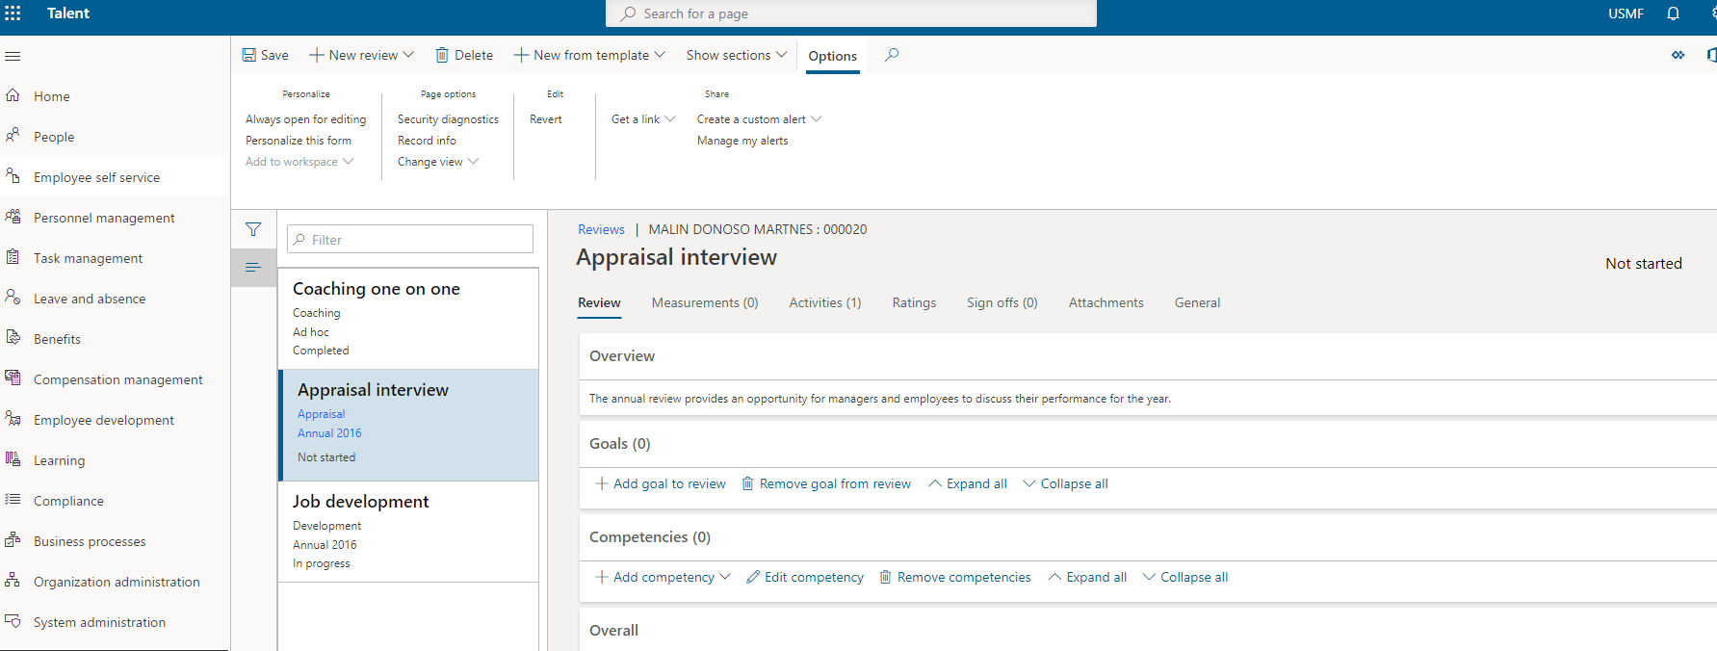
HR
Manager
Employee

Slide 39
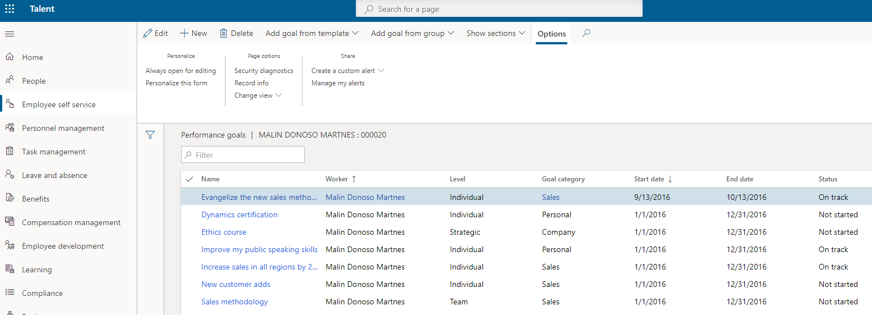
HR
Manager
Employee

Slide 40
Ferie og fravær

Slide 41
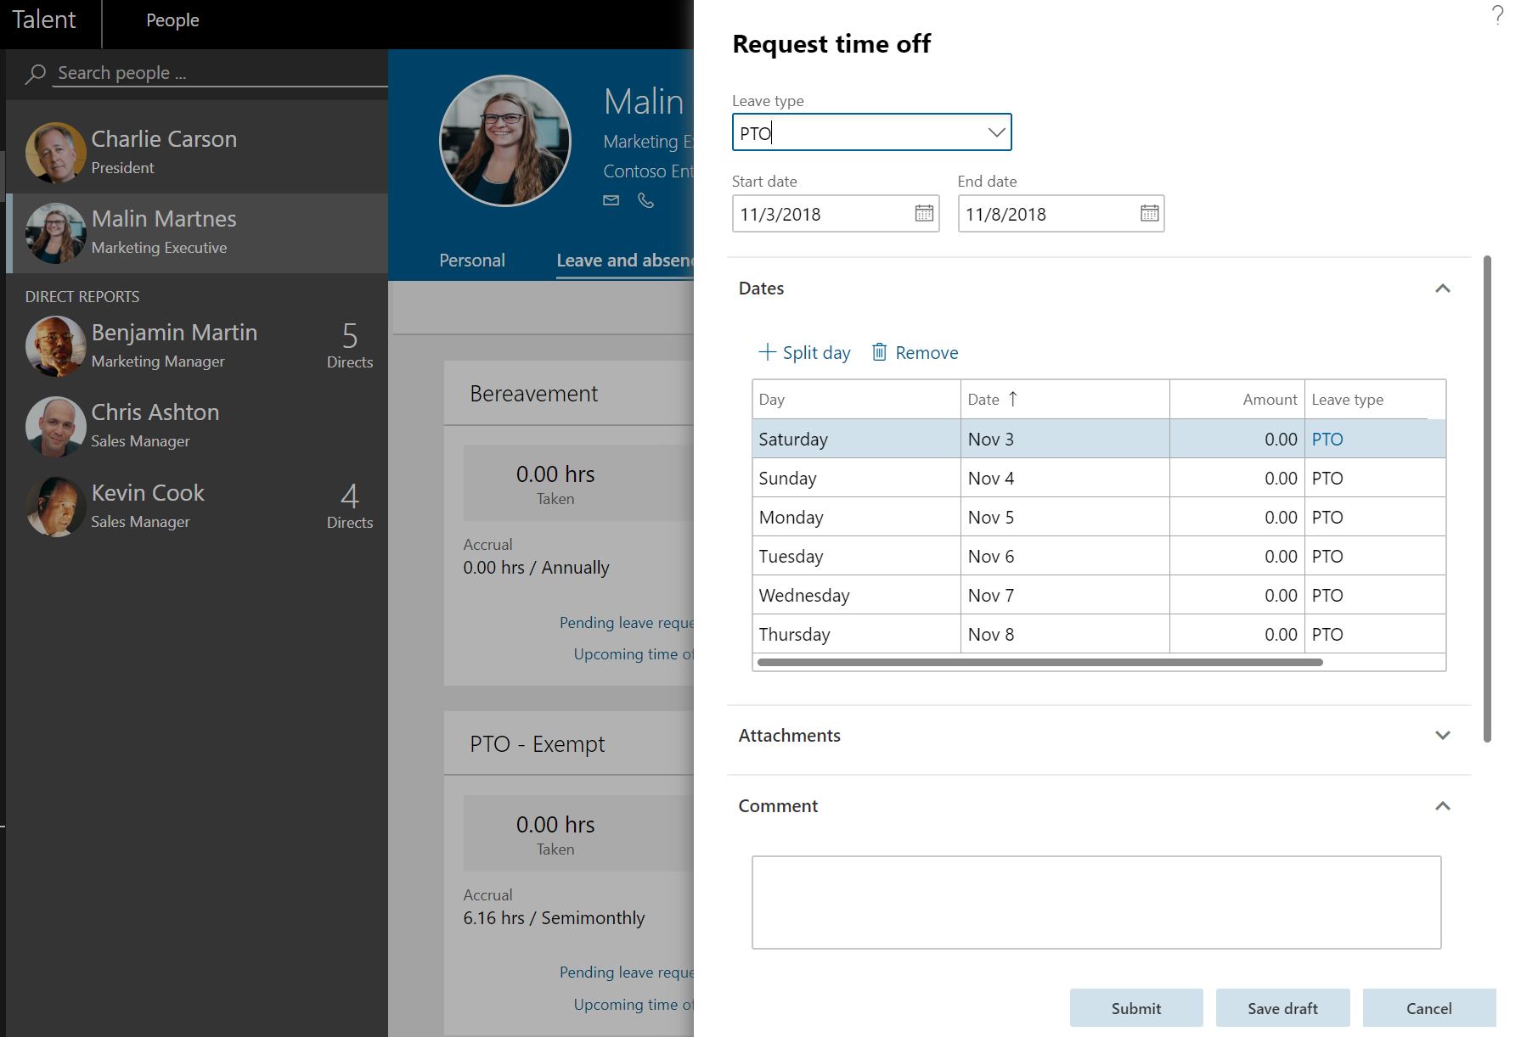
HR
Manager
Employee

Slide 42
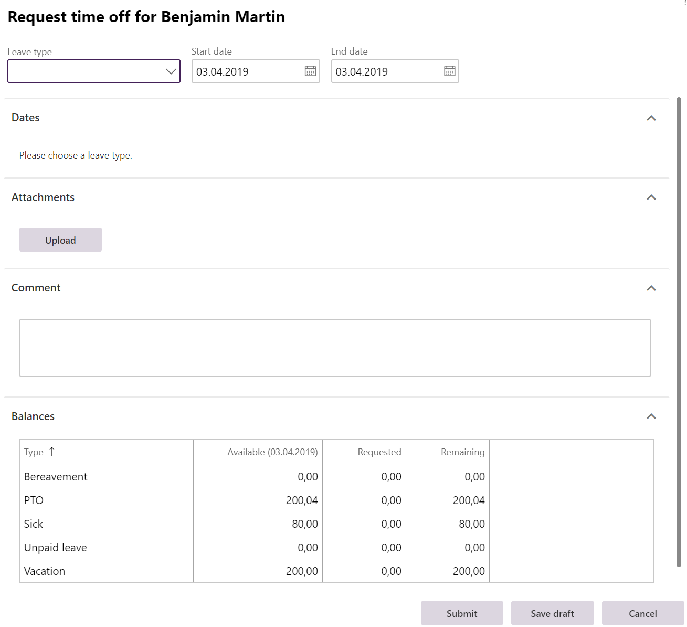
HR
Manager
Employee

Slide 43
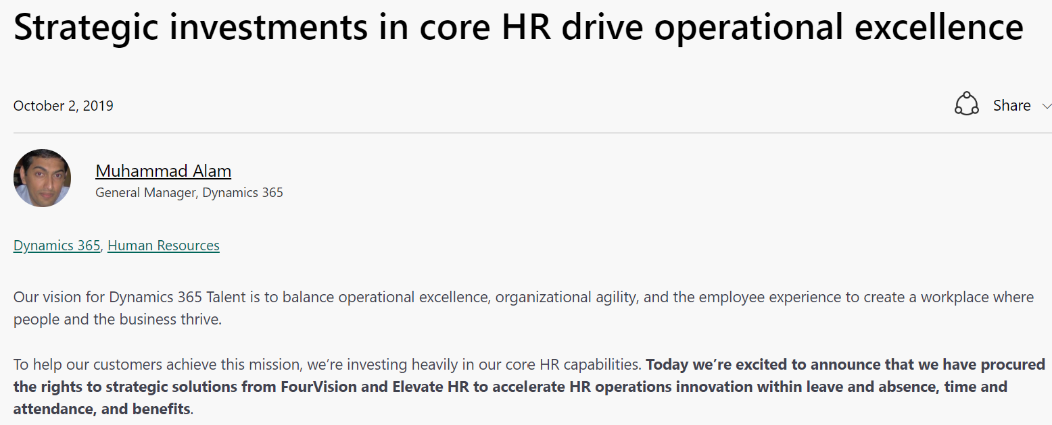

Slide 44
Integrasjon

Slide 45
Kontakt informasjon
https://malinsdynamics365fortalent.com/
https://www.linkedin.com/in/malinmartnes/
https://twitter.com/MalinMartnes - @MalinMartnes
Malin_martnes@hotmail.com
https://www.meetup.com/Women-in-Dynamics/
http://tiny.cc/MalinMVP

