Slide 1
Driving a data culture
From insight to action
Oslo, May 2020, Hans Kristiansen

Slide 2
Innovation
Our vision for Power BI is to help our customers drive a data culture – helping everyone make better decisions based on data.
We are innovating in three major areas to help our customers drive a data culture.

Slide 3
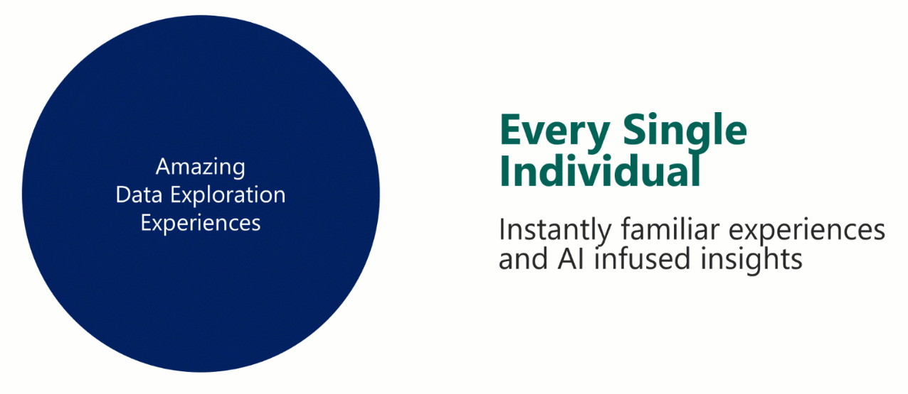
Self-Service BI

Slide 4
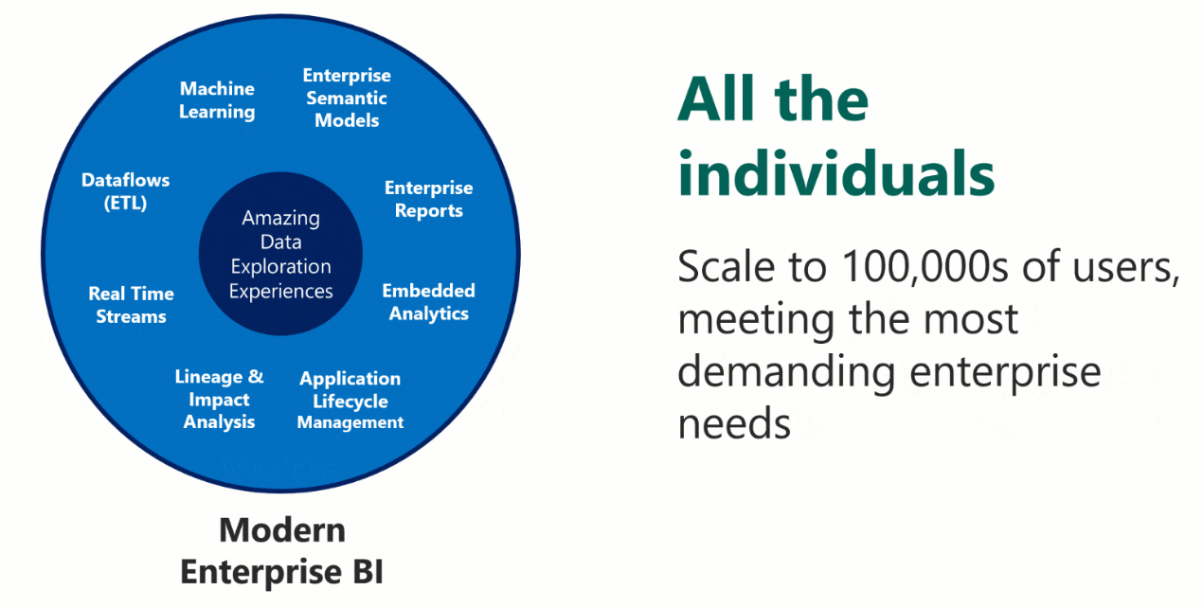
Enterprise BI

Slide 5
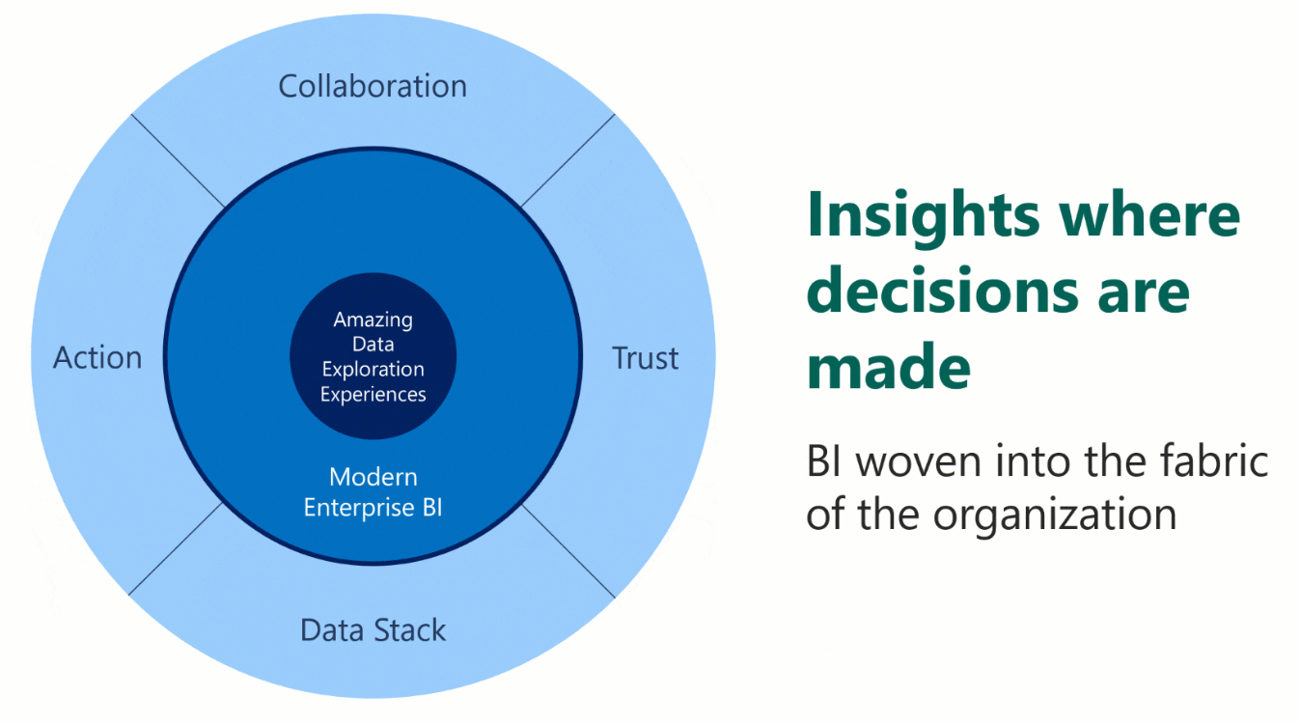
Data Culture

Slide 6
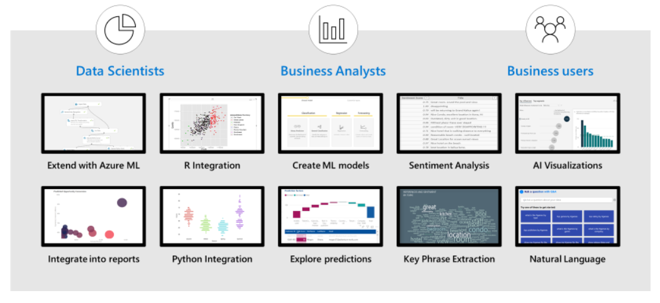
AI Powered Analytics in Power BI

Slide 7
Power BI announcements - Availability
1. Available today
2. Available later this month
3. Available later this year

Slide 8
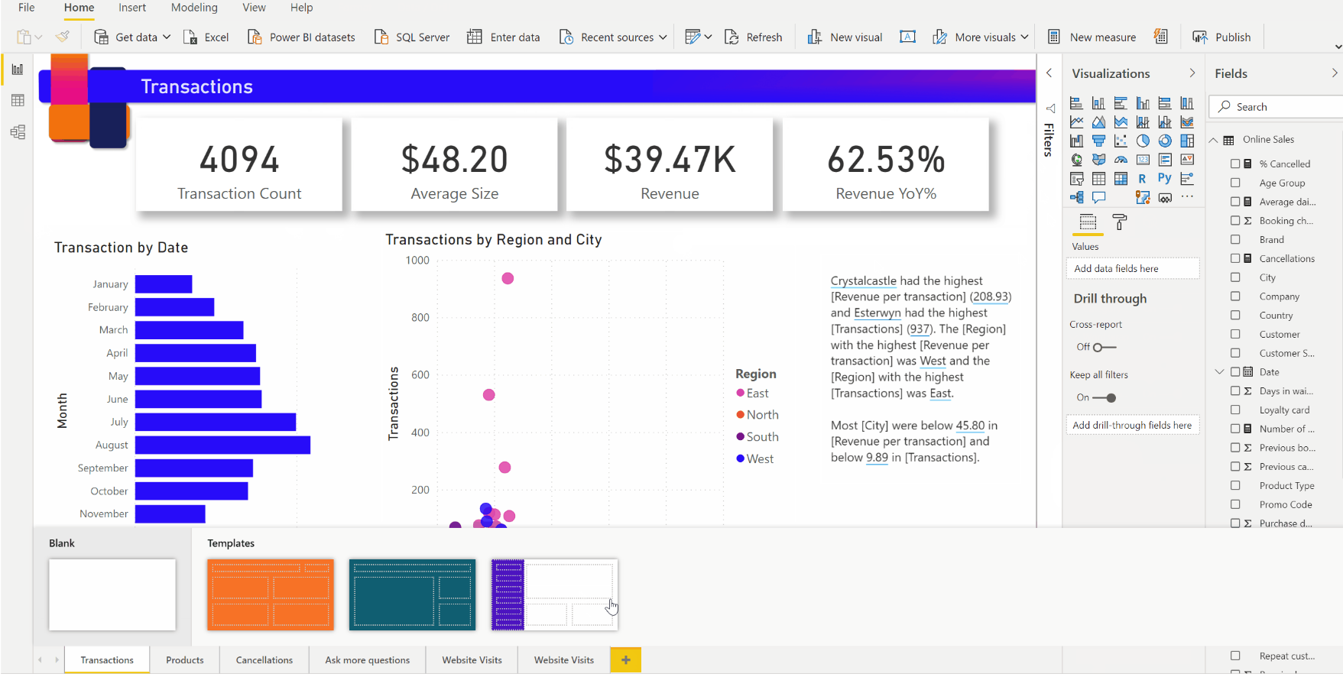
PowerPoint for data – Page templates³
Report authors will get help in building and laying out report pages with pre-made templates like PowerPoint layouts.

Slide 9
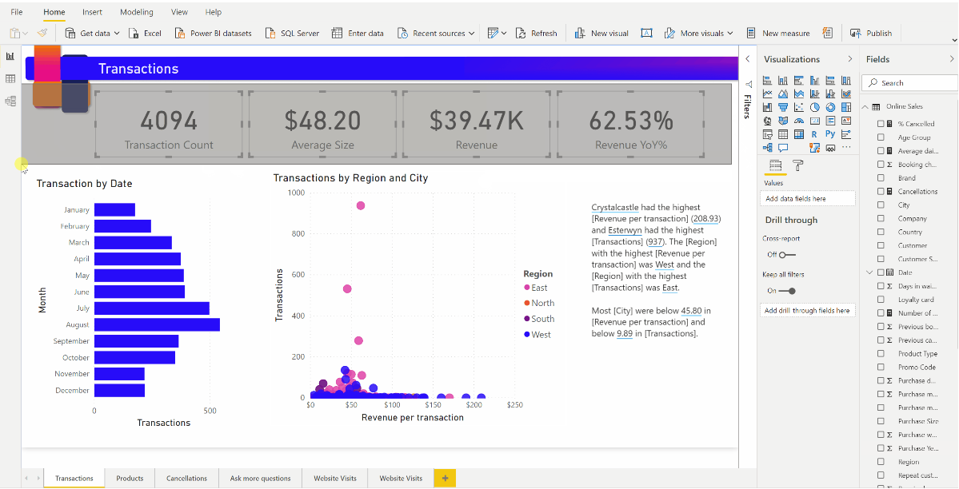
PowerPoint for data – Lasso select of visuals and datapoints¹
Users will be able to drag a rectangle around visuals to select many of them at once, and within charts to quickly select multiple data points.

Slide 10
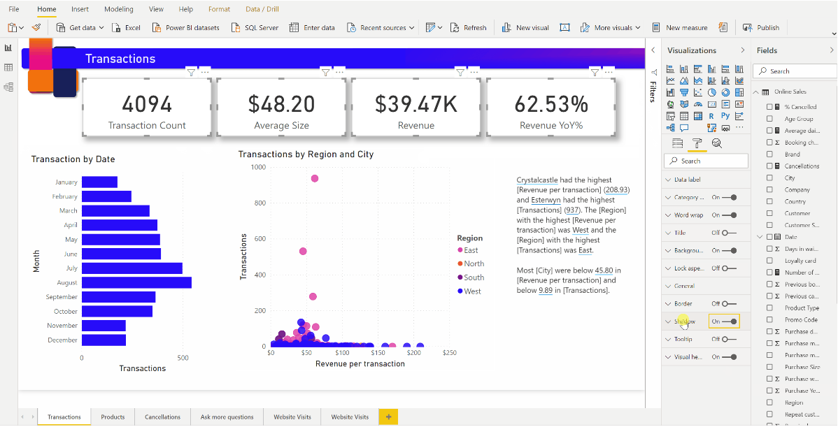
PowerPoint for data - Drop shadows²
We are bringing the shadow effects that you can apply to shapes in PowerPoint to all Power BI visuals.

Slide 11
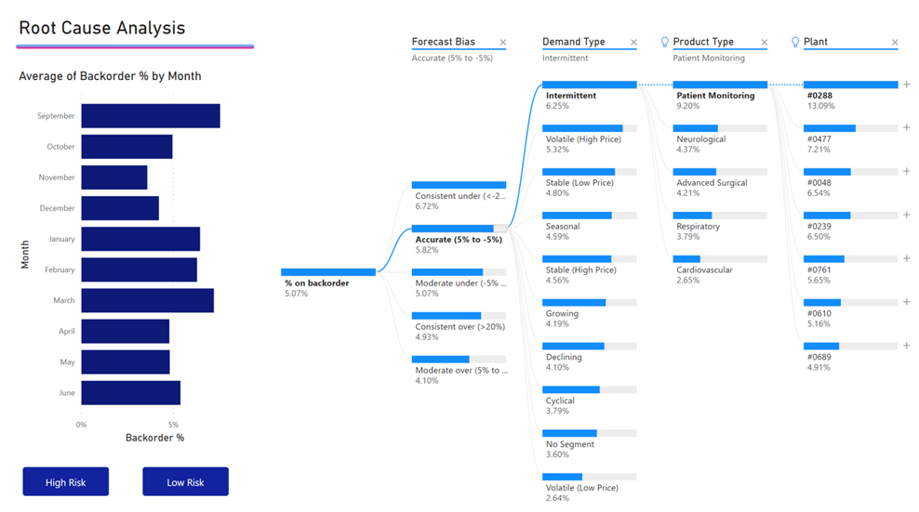
AI - Decomposition tree (GA)²
The decomposition tree will support conditional formatting, drill through, pinning to dashboard, connectivity to Direct Query as well as a new responsive design

Slide 12
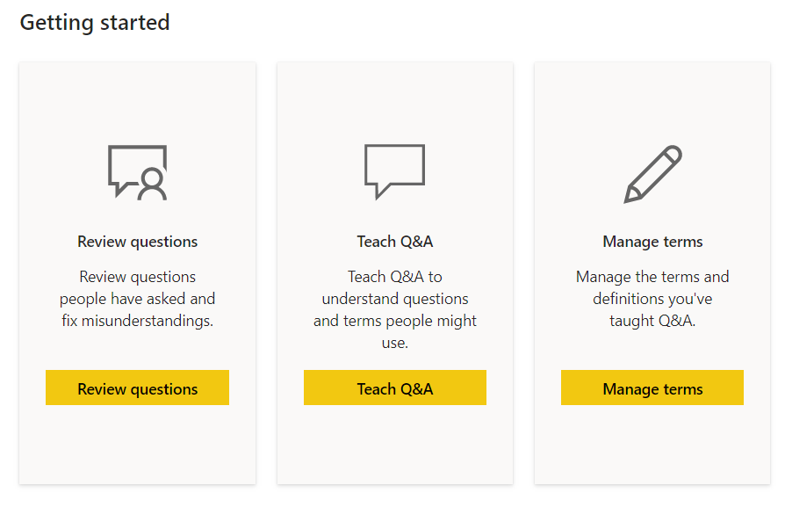
Q&A updates³
Making improvements to Q&A will now be simplified through a bulk synonym editor, the ability to add your own suggested questions as well as automatic synonym generation based on report renames.

Slide 13
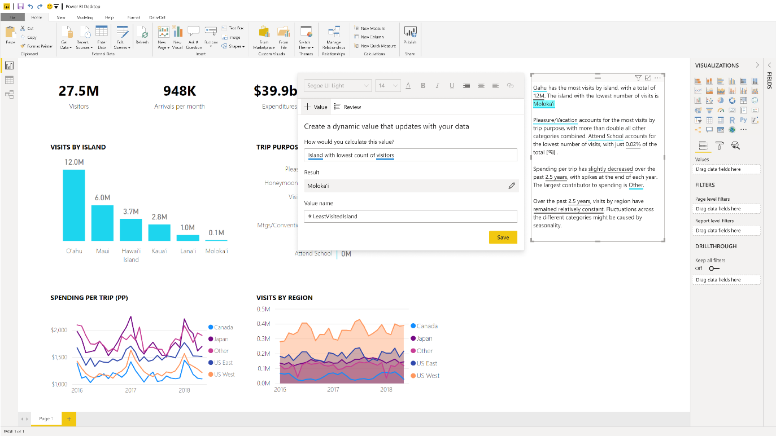
Smart narratives (sneak peek)³
Report authors will be able to add and tailor dynamic, interactive narratives to reports that are automatically generated by Power BI. End users get clear explanations that are continuously updated as they slice and dice the data.

Slide 14
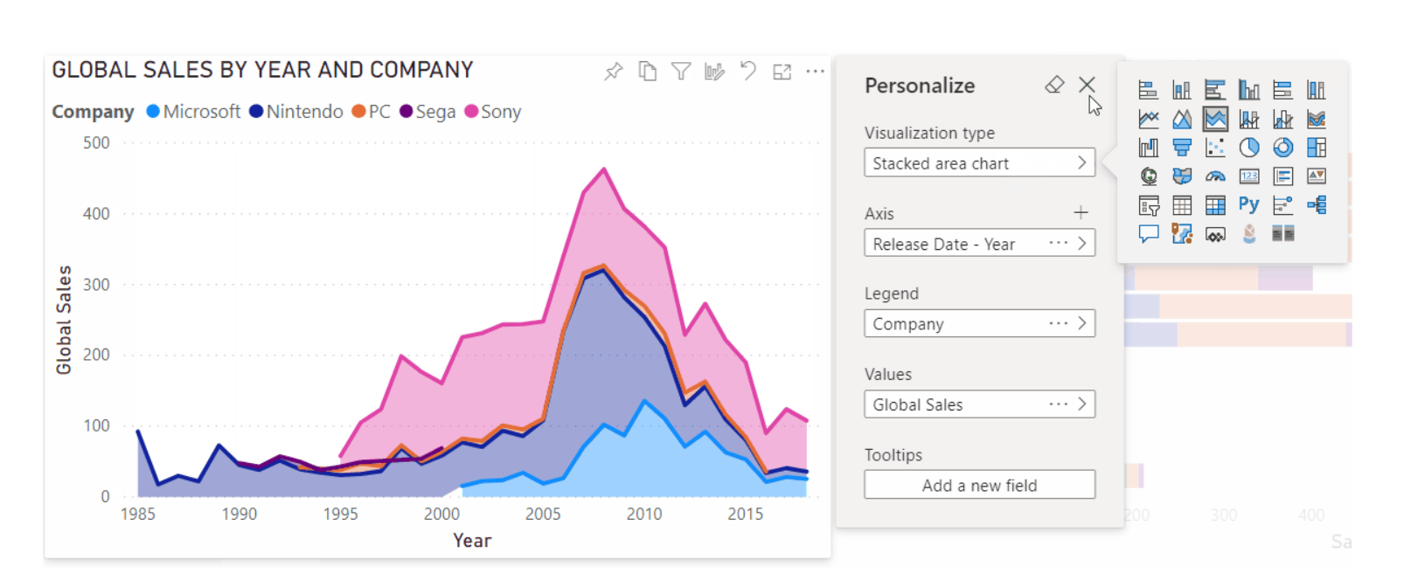
Personalized visuals (preview)¹
Report authors can now empower end-users to explore and personalize visuals when consuming a report based on their unique needs.

Slide 15
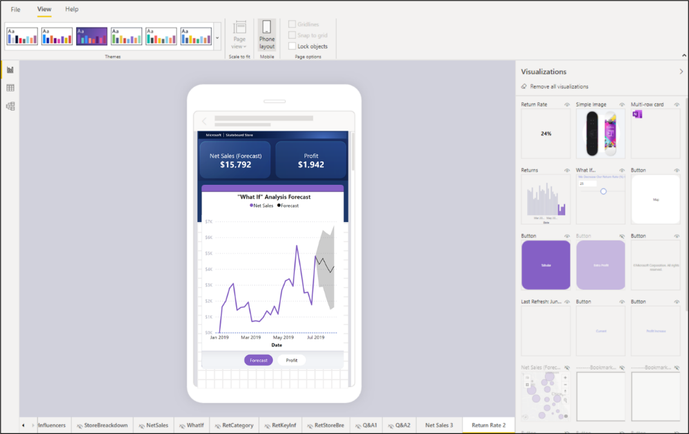
Updated mobile report authoring experience²
It will provide report authors with more flexibility, real estate, and tools to create stunning mobile versions of their existing reports.

Slide 16
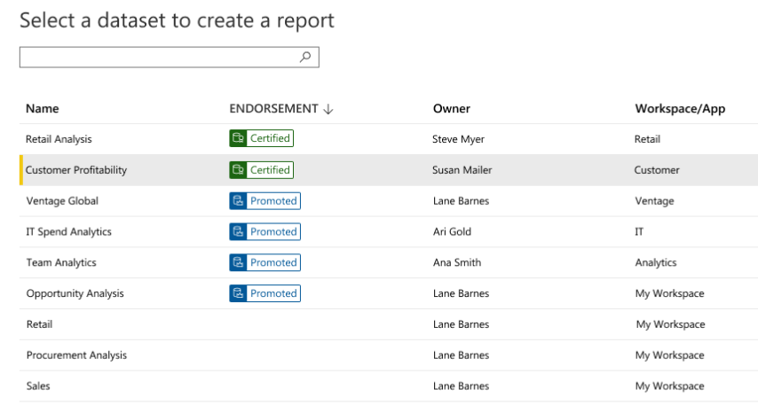
Enterprise semantic models - Shared and certified datasets (GA)¹
Helping Power BI users to build reports based on trustworthy, authoritative data through discovery and reuse enterprise-wide semantic models.

Slide 17
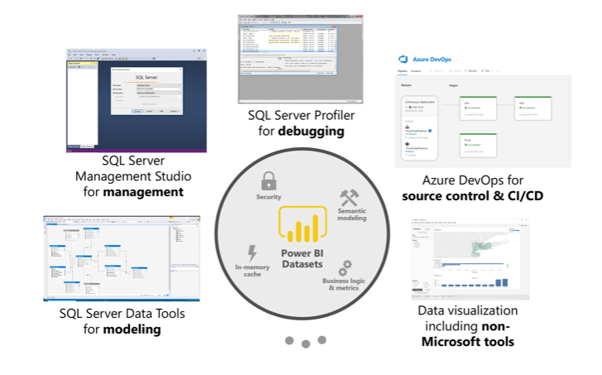
Enterprise semantic models - XMLA read/write (preview)¹
Providing industry standard open-platform connectivity now introducing many additional scenarios for dataset management, advanced semantic modeling, debugging, and monitoring.

Slide 18
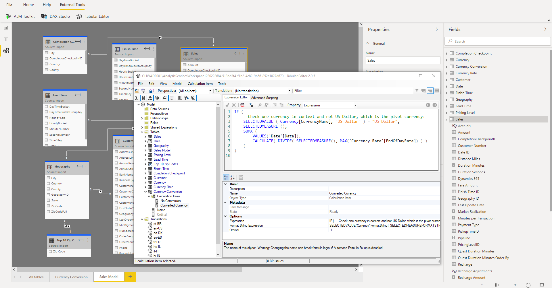
Enterprise semantic models - Pro extensibility (sneak peek)³
Power BI Desktop enables external-tool extensibility to unlock additional semantic modeling capabilities in the Analysis Services engine.

Slide 19
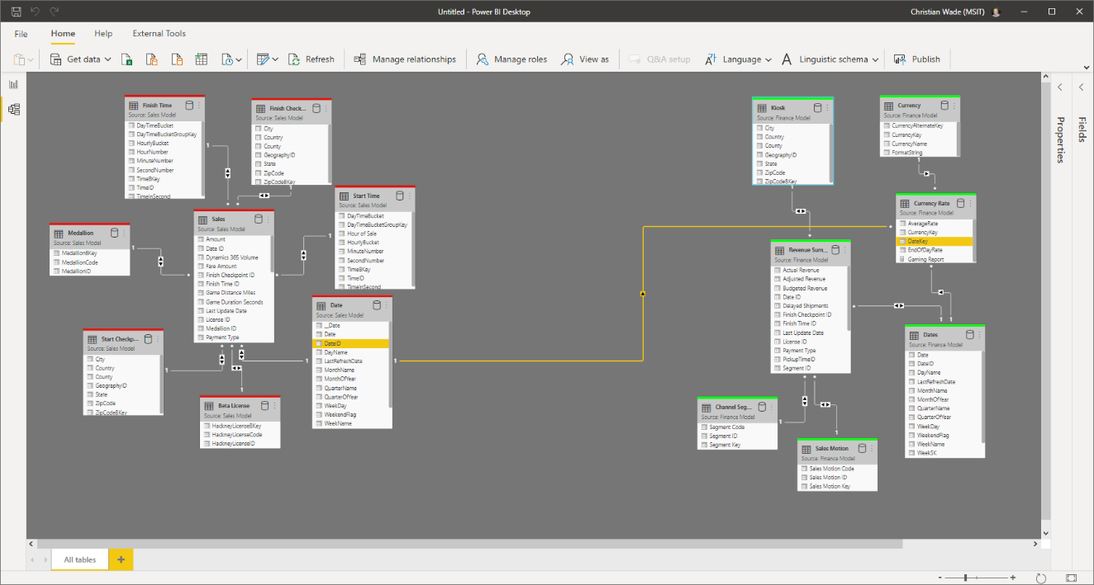
Composite models over Power BI and Azure Analysis Services datasets (sneak peek)³
Allowing business analysts to extend or modify semantic models from IT with their own measures or combine them with other imported data (e.g., from Excel files).

Slide 20
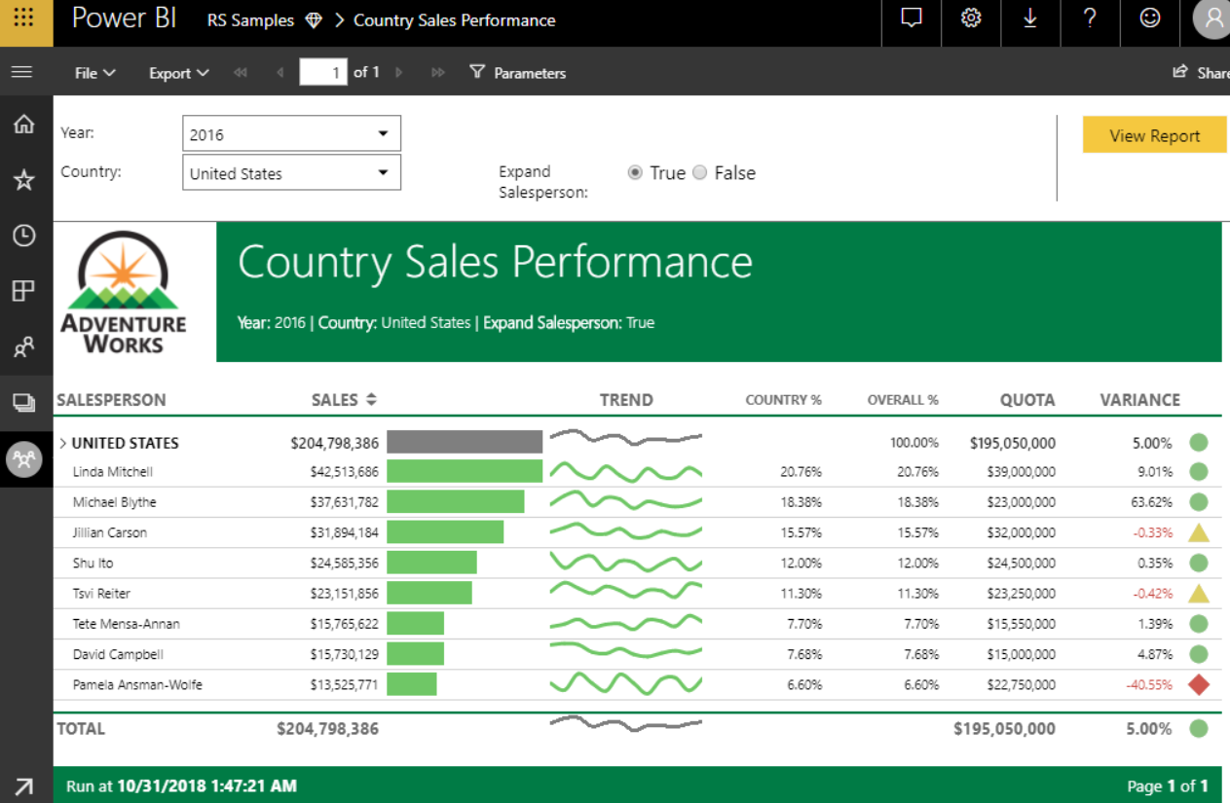
Enterprise reports¹
With sub-reports, authors can embed one or more paginated reports into another with full parameter support, thus enabling true master-detail reports that support a wide range of complex business needs.

Slide 21
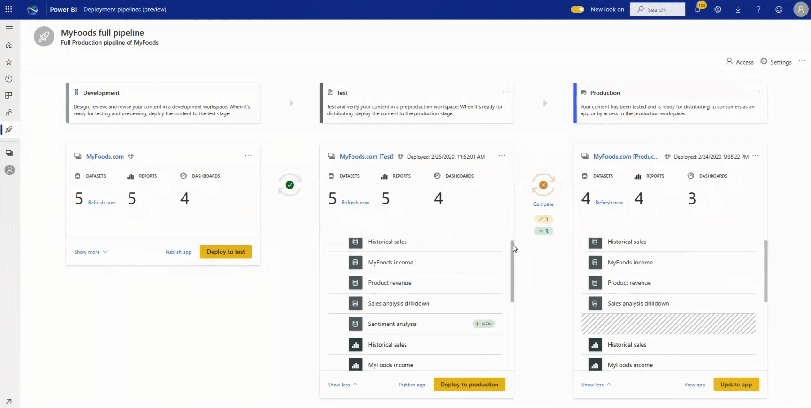
Application lifecycle management²
Deployment pipelines (preview) allows content creators to improve Power BI content publishing efficiency and accuracy by moving it through development, test, and production environments.

Slide 22
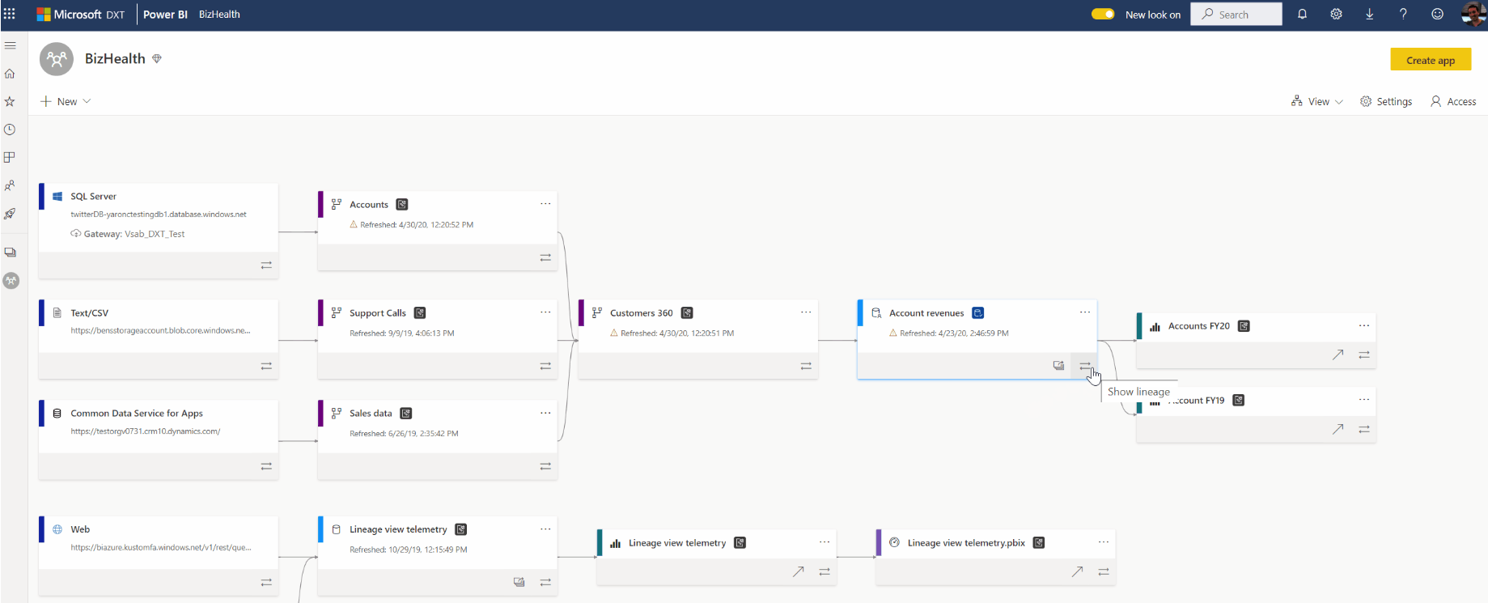
Data lineage and impact analysis (GA)¹
Visualize the entire data journey from a given workspace, making it easy to determine the upstream and downstream dependencies of Power BI artifacts, derive impact analysis, examine artifact information, and take action when needed.

Slide 23
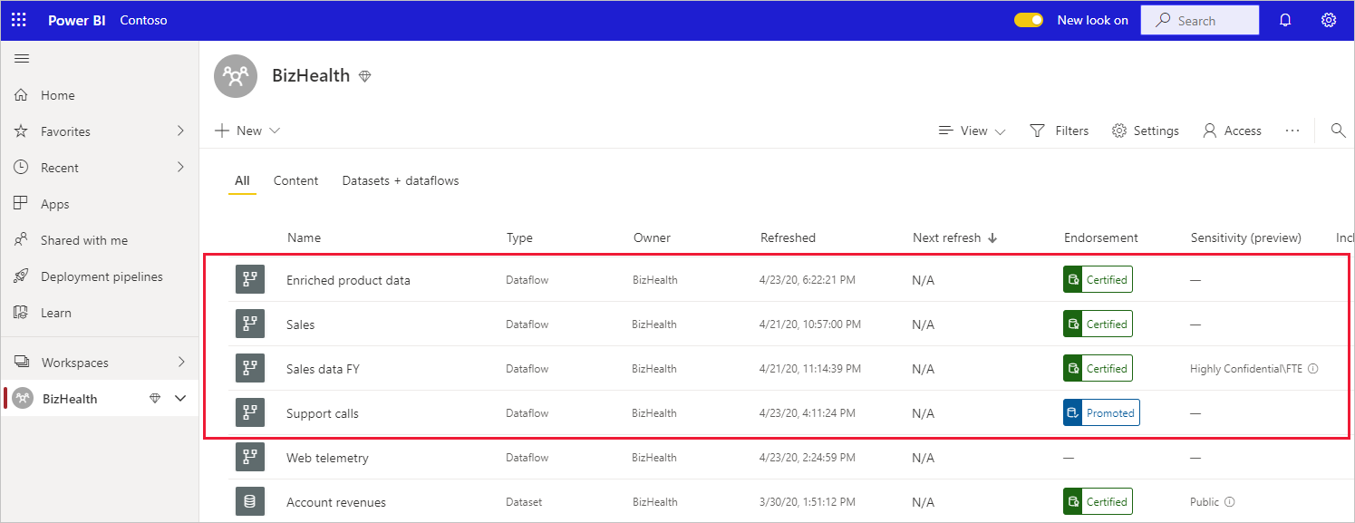
Power BI Dataflows – self-service data prep on Azure Data Lake Gen2 - Certified dataflows (preview)¹
Following dataset certification, Power BI now supports certification of dataflows as well, thus helping users find and identify trusted, quality sources for reuse.

Slide 24
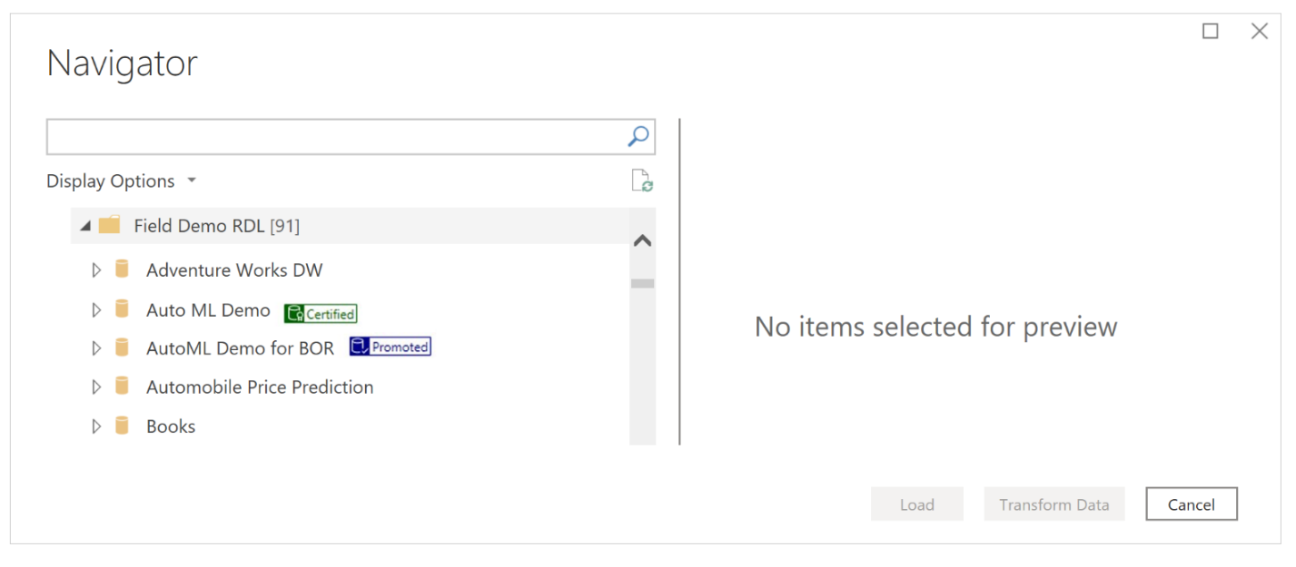
Power BI Dataflows – self-service data prep on Azure Data Lake Gen2 - Dataflows DirectQuery support (preview)³
Allowing authors to connect to dataflows in Direct Query mode.

Slide 25
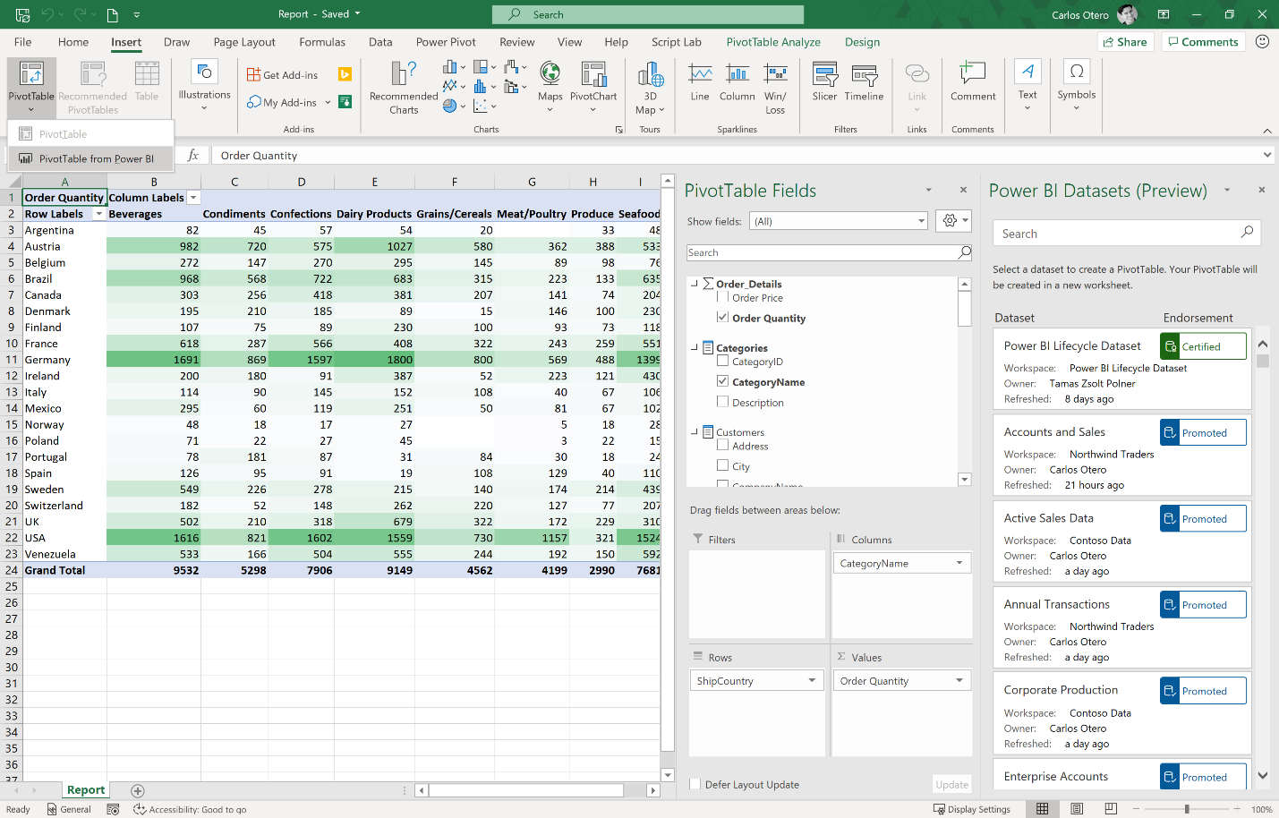
Connect to Power BI Datasets without leaving Excel (preview)³
With the click of a button users can now discover Power BI datasets all without having to leave Excel.

Slide 26
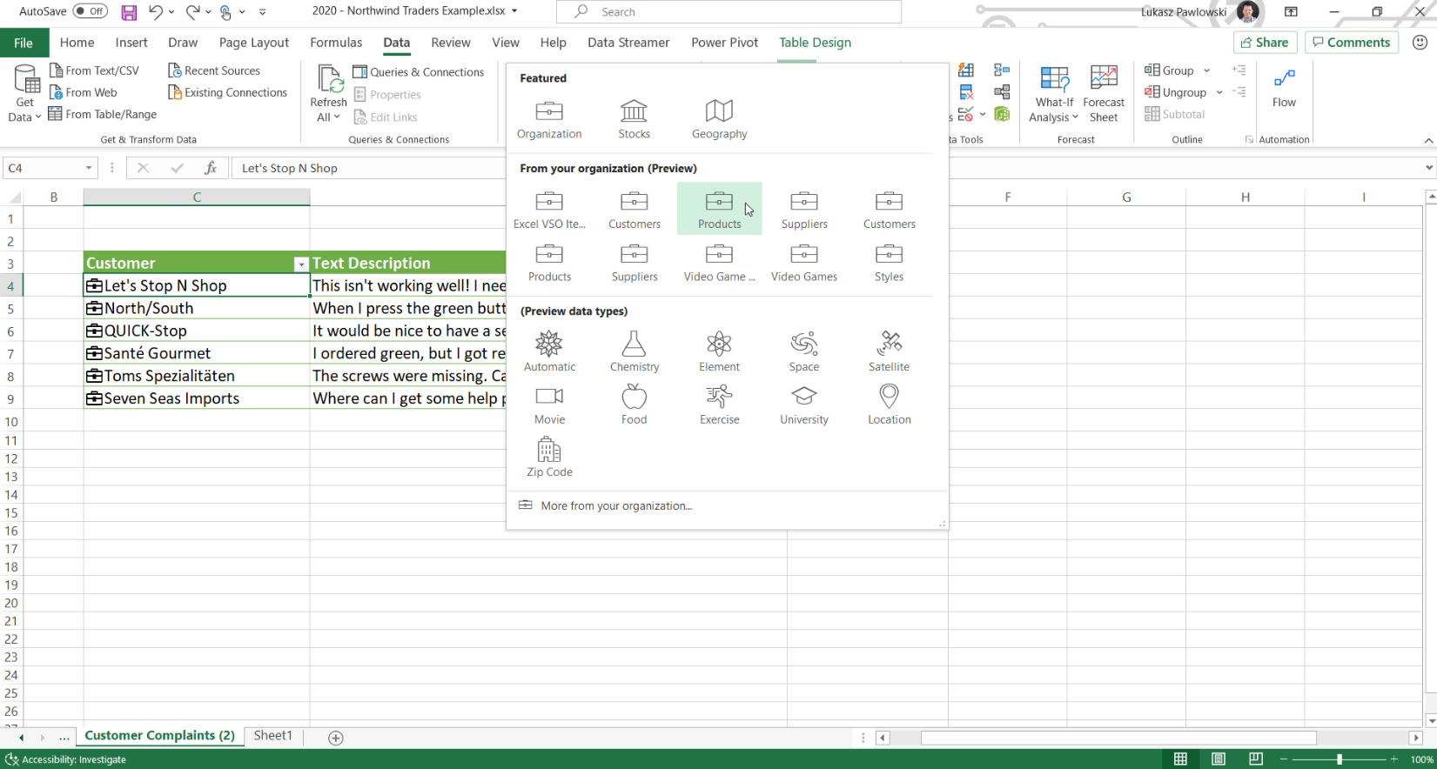
Curated featured tables for Excel (preview)3
Using Data Types, you can quickly find details from featured tables in Power BI datasets within Excel’s data types gallery giving users the flexibility to organize information in any way they want within the Excel grid.

Slide 27
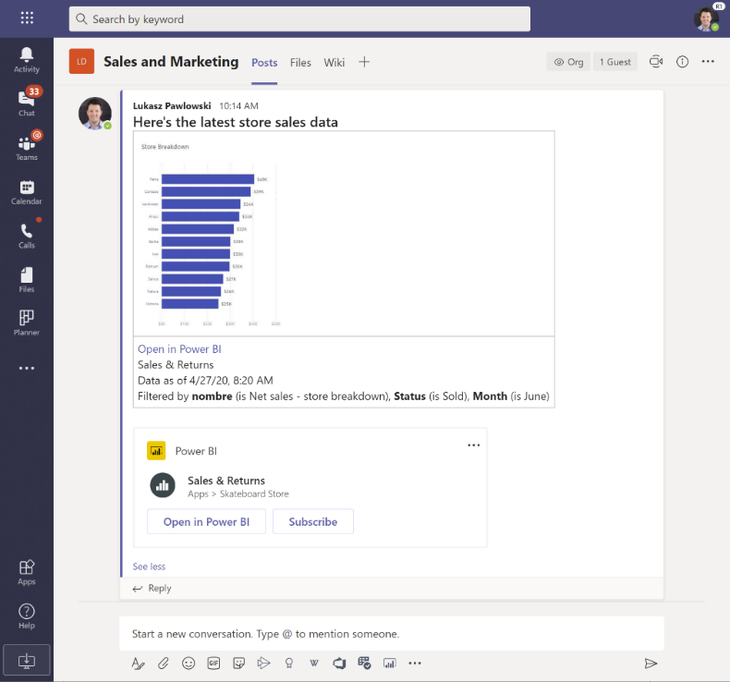
Updated experiences with Microsoft Teams (Preview)1
New Power BI tab and preview links allow teams to foster a data culture and make data driven decision making become part of their routine.

Slide 28
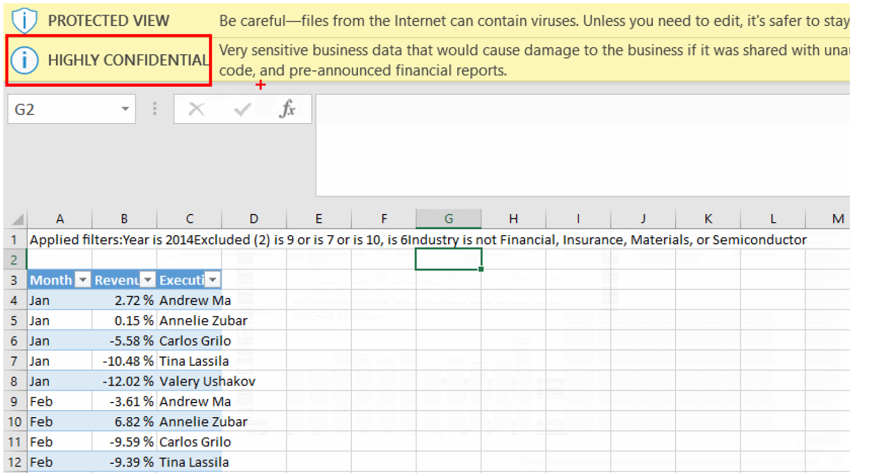
Data Protection in Power BI (GA)2
Power BI now enables customers to protect their data even when it is exported out of Power BI into Excel, PowerPoint, or PDF using Microsoft Information Protection.
Power BI also leverages Microsoft Cloud App Security to continuously monitor access to Power BI and flagging any suspicious access such impossible travel activity.

Slide 29
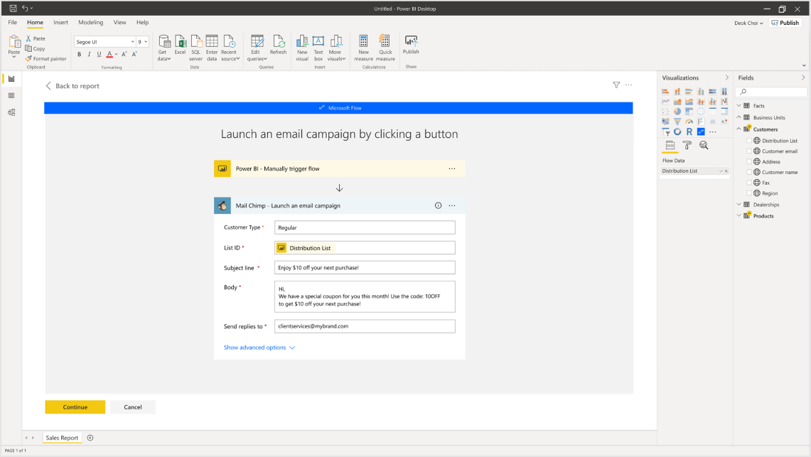
Power Automate visual (sneak peek)3
Kick off flows directly from a Power BI report using the new Power automate visual leveraging the context of your data.

Slide 30
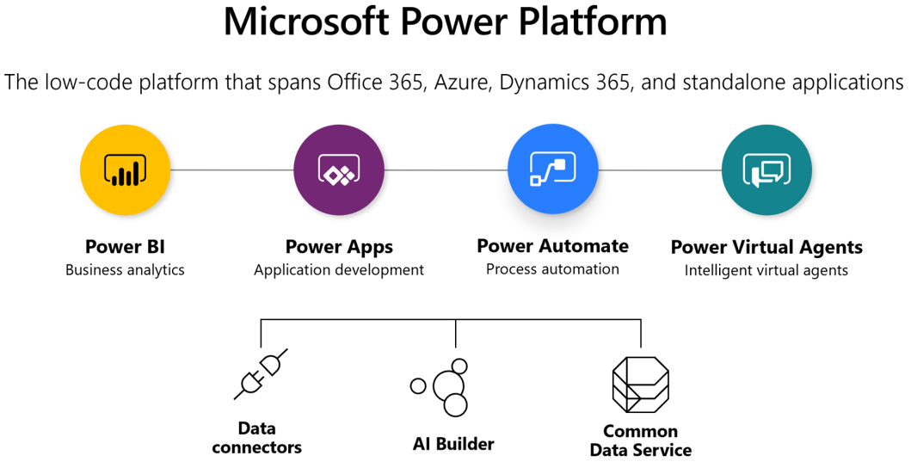
Common Data Service DirectQuery support (sneak peek)³
The Microsoft Common data service connector now supports DirectQuery mode bringing all the benefits of connecting directly to the source such as security, single source of truth, and near real-time data visualization with automatic page refresh.

