Slide 1
Center of excellence
Thomas Mittelbach
Thomas Mittelbach
Managing Business Analyst
Mai │ 2022
Notes:
What is CoE Governance?
How is Governance managed in CoE?
Why is Governance a mandatory part of Power Platform CoE?

Slide 2
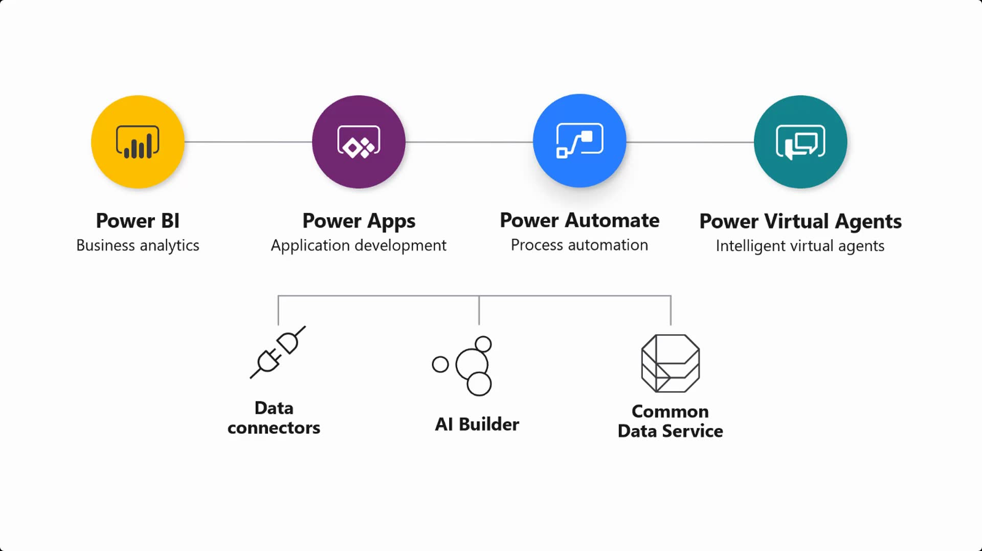

Slide 3
How mature is your organization?

Slide 4
Why create a power platform coe?
A CoE brings structure to your Power Platform environment(s)

Slide 5
Some good reasons for using center of excellence
You lack visibility into the number of apps being created and their owners;
Users have changed roles or left the company, leaving behind orphaned apps;
Users have been assigned an admin security role, putting sensitive information at risk
Automated processes run in production when they shouldn’t…
New makers have access to far too much content
Lack of governance for your PowerPlatform

Slide 6
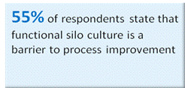
Governance – the foundation of coe
A Governance model is a framework for resolving inter-silo issues
Governance fuels collaboration between departments
How do you prevent silo challenges?
How does CxO involvement translate into better results?
The answer is Governance!
Capgemini global survey 2021
«Governance will help your users to overcome roadblocks and navigate around them»

Slide 7
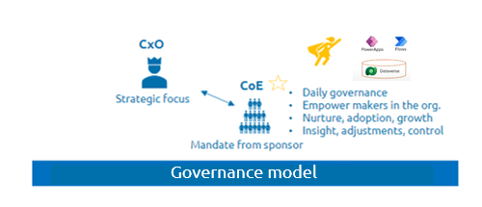
GOVERNANCE – THE FOUNDATION OF COE continued
CxOs’ input to BPM is critically important, but they rarely have the time.
Let the CxO focus on strategic BPM by giving CoE the mandate to handle day to day Governance and silo obstacles.
A CoE that has clear backing from a BPM-aware CxO, acts as an extension of the CxO, helping to ensure that BPM is taken seriously by the whole organization.
The roles of the CoE must include:
Aligning goals and obectives
Resolving disputes about priorities and methods
Allocating resources
The CxO acting as a power sponsor focusing on strategic business process management – BPM ++

Slide 8
A governance plan should include
A description of object and scope
Environments; Personal productivity and environment strategy, environments for Teams
Azure DevOps: ALM accelerator, moving objects between environments ++
License and capacity allocation: Per App plan, per user plan, pay as you go plan
Security and access: Roles and groups, Sharing apps/flows, Secure data and network, App/Flow Authenticating data sources
Data loss prevention (DLP) policies; access policies for environments, connectors, env and tennant level DLP
Audit Logs
Archiving and cleanup, orphaned apps and flows
Governance never ends

Slide 9
Power platform Coe and Adoption framework
CoE and Governance
Training/Support/Adoption
1. Secure
2 Monitor
3. Alert Action
4. Deploy
1. Nurture
2. Infrastructure and tools
Governance and Setup
Nurture and Growth
Environment
strategy and
governance
Data loss prevention
Security roles and admin
Installation and development of CoE starter kit tools
Automated processes for creating new Apps/Flows
Monitor out of box analytics
Configure audit logs
Utilization of management conncetors and Powershell reporting
Installation and development of CoE starter kit tools
Utilization of management connectors and PowerShell for reporting
Welcome new makers an foster best practices
Installation and development of CoE starter kit tools
Request Funnel
Deploy with solutions through environments
Establish effective Application Lifecycle management (ALM)
Setup and utilize ALM toolset and best practices
QA check of apps for production
Dev Ops
Evangelism and training
Technical guidance
Identify and train CoE champions/super users
App in a day sessions
Citizen Developer Program
CoE to build assist complex requests
Tools and components
Infrastrucure environment automation
Reusable components
Reusable custom Power Component framework builds
Self Service
Adoption journey with value realization ws

Slide 10
Power Pods
You build it – you run it: the roles and structure needed for successful POD-based model implementation
The POD-based model is centered on the DevOps best practice of “you build it – you run it.” This means POD teams assume full ownership and accountability for a product from build to support.
A POD-based model consists of dedicated roles with complementary skills that are confined to a POD, shared roles that are spread across the PODs as needed, and CoE teams that define standards:
Dedicated roles – POD model dedicated roles include:
Scrum Master
Product/Tech Lead (for detailed design/architecture)
Technical/Business Analyst
UI Developer(s)
Back-end Developer(s)
SDET (Software Development Engineers and Testers)
DevSecOps Engineers and Cloud Engineers.
Shared roles – POD model shared roles used across PODs include:
Governance roles – Product Director and Product Owner
Coaching roles – Agile/DevOps Coach(s)
Architects – Enterprise, Application, Data, Cloud, Security, etc.
SRE – Site/Service Reliability Engineering Specialists
Source: https://www.capgemini.com/insights/expert-perspectives/how-to-design-and-implement-a-pod-based-devops-operating-model/

Slide 11
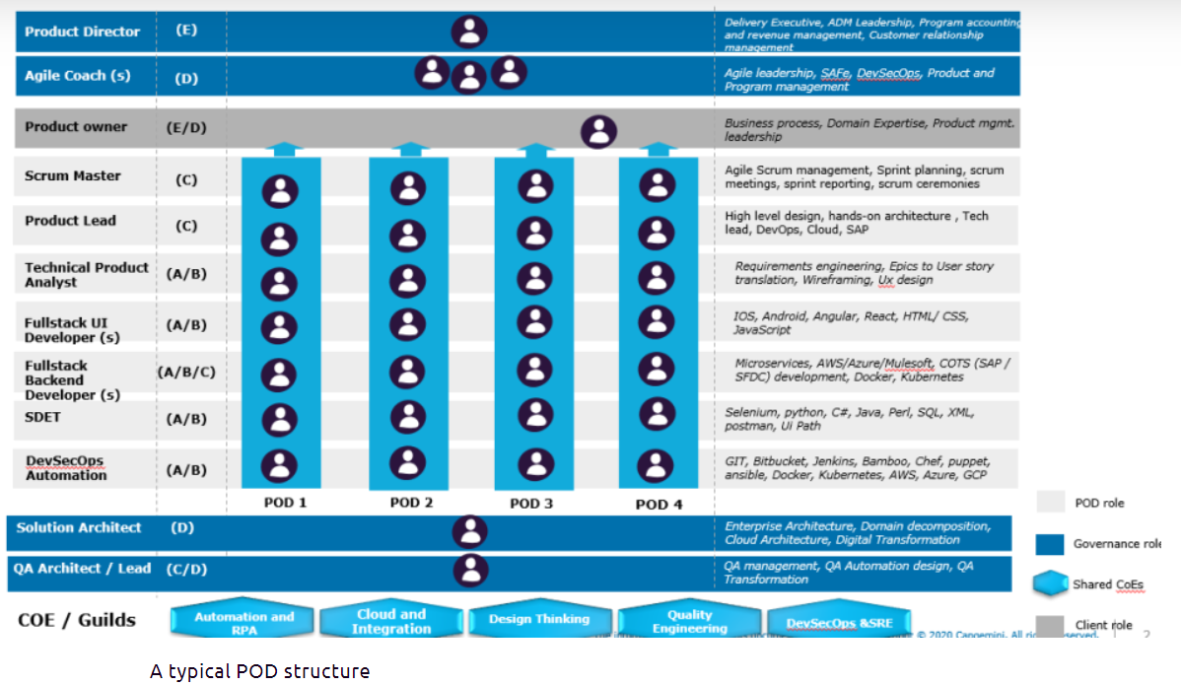

Slide 12
How capgemini sets up and runs power platform coe to provide continuous innovation for our customers

Slide 14
Thank you! CoE + governance = success

