Slide 1
Business applications meet cloud scale analytics
Microsoft Fabric and Dynamics 365:
Better Together
Scott Sewell
Principal Product Manager
Microsoft Fabric CAT
Notes:
Introduce Microsoft Team to the Customer

Slide 2









Scott Sewell
Principal Program Manager, Microsoft
Tennessee, USA
https://www.linkedin.com/in/MScottSewell/
@ScottSewell
Scott.Sewell@Microsoft.com
https://www.youtube.com/@MSFT_ScottSewell
FabricCAT

Slide 3

CONTENTS
01
05
The business agility and analytics landscape
Integrating Fabric and Dynamics 365
02
06
Business applications meet cloud scale analytics
Getting started
03
Microsoft Fabric capabilities
04
The art of the possible
Notes:
In the next 30 minutes, we will show you how you can connect and optimize your business applications with Dynamics 365 and Microsoft Fabric.​
​
What you’ll take away from this presentation is an understanding of:​​
What we’ve heard from conversations with customers​ and today’s current business agility and analytics landscape​
How these two platforms integrate and augment one another​
An example of how the data experiences in Fabric can be used to enhance business applications
How to get started

Slide 4
The business agility and analytics landscape

Slide 5

Title1
CIOs are accelerating their efforts to bring AI to their data estate
Notes:
This excitement means data leaders are scrambling to bring AI to their organization. But as you prepare for a future built on AI, you also need clean data to fuel AI. Fostering game-changing AI innovation requires a well-orchestrated data estate that can support everything from small AI pet-projects to scalable AI solution that span the company.

Slide 6


Title
of organizations believe
AI will give them a competitive edge
87%
Source: MIT Sloan Management Review
Notes:
And most believe they will be successful—with 87% of organizations believing AI will give them a competitive edge.

Slide 7
The need for businesses to link people, data, and processes is greater than ever before
71%
77%
86%
Businesses are not able to respond quickly enough to changing market conditions, with 71% reporting low agility¹
Percentage of businesses that reported experiencing a skills shortage in 2023²
See scalability and the ability to grow and adapt with the business, as key to success¹
¹Business Agility Institute
²Forbes
7
Microsoft Fabric
Notes:
Over the last several years, we’ve seen just how critical it is for businesses to evolve and adapt to shifting market conditions, modernizing their infrastructure to become more resilient to disruptions and maintain their competitive edge.
Leading into 2023, however, 71% of businesses reported low agility and expressed inability to respond quickly to changing market conditions. Organizations are striving for agility, but even with committed investment in modernization, 77% of organizations are also experiencing a talent shortage, unable to keep up with the current pace of change and without the skillsets needed to execute against the changing market landscape. Not only that, but 43% of business leaders are reporting that skills shortages are top concern and can delay digital transformation efforts from anywhere between six and 12 months.
There is a significant need to connect people, data, and processes, increasing visibility across legacy systems and optimizing for scalability and growth, and 86% of businesses see scalability and the ability for their business to adapt as a key to success.
___________________________________________________________________________________
Other stats:
Data volume is growing at a rapid pace – expected to grow 2x by 2026 (IDC datascape suvey 2022)
IDC global IT skills survey (June 2023): 43% business leaders cite skills shortage as the main concern, delays digital transformation projects by 6-12 months

Slide 8


The starting line
A complex, organically evolved data estate
Several
1
Data copies and infrastructure inefficiencies
Business team
Business team
Business team
Tech team
Tech team
Limited interoperability between vendor services
2
Vendor 4: Compute and serving
Vendor 4: Compute and serving
Vendor 3: Data management
Vendor 3: Data management
Vendor 2: Storage
Vendor 2: Storage
Vendor 1: Ingestion
Vendor 1: Ingestion
3
Data exposure risks
Enterprise data sources
Notes:
This is a challenging prospect for most organizations whose data environments have grown organically over time with specialized and fragmented solutions. A complex data estate leads to data sprawl and duplication, infrastructure inefficiencies, limited interoperability, and even data exposure risks—not an ideal place to start your AI innovation.
This is why, when I talk to Chief Data Officers, the message I consistently hear is, "Please help me simplify. I want to be the Chief Data Officer, not the Chief Integration Officer."

Slide 9
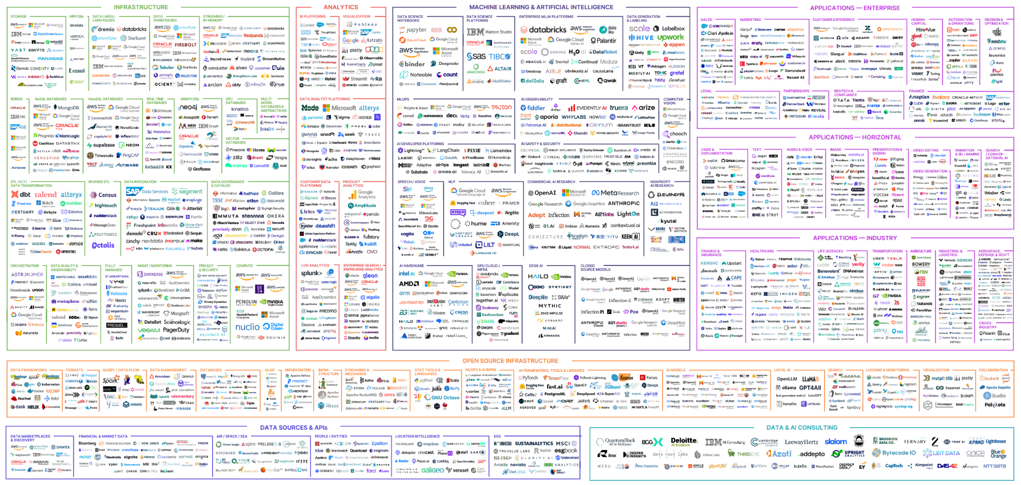
Customers enhancing their data estate face immense complexity
Notes:
For organizations trying to streamline and advance their data estate, the burden is often on you to search through the thousands of data and AI offerings, find the right set of offerings, figure out how to integrate them, and do it in such a way that is scalable and can evolve over time. Most data leaders would rather focus on the outcomes of their tools rather than spend all their time integrating specialized solutions and maintaining their data estate.
The 2024 MAD landscape features 2,011 logos in total.
That number is up from 1,416 last year, with 578 new entrants to the map.
For reference, the very first version in 2012 had just 139 logos.

Slide 10
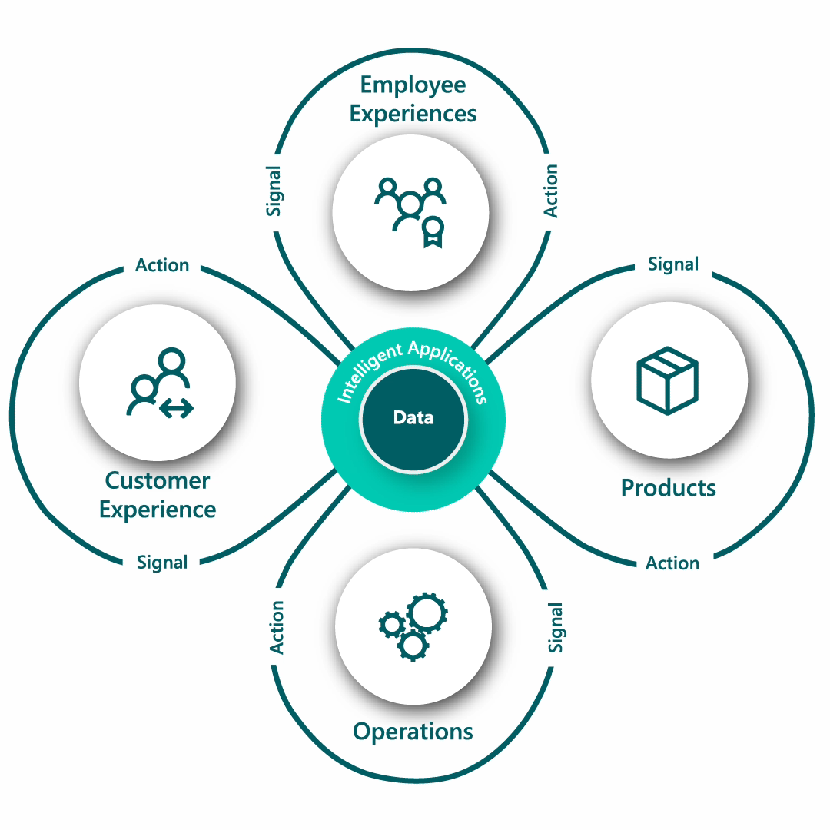
Unified analytics modernization is the key to shaping the future of your business
Data and analytics are core to every business and application that drives experiences
Notes:
In the coming years, 75% of organizations will move to a single source of truth for their data with ability to support federated data-driven initiatives like business application modernization – enabling easier ERP and CRM application optimization and collaboration, with unified and comprehensive data and insights – and the ability to empower business users with insights to drive business outcomes through those applications.

Slide 11
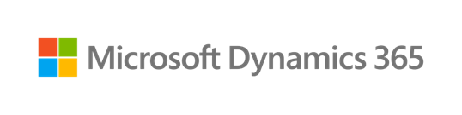







Unlock cross-organizational impact by uniting disparate data sources
Business data
& processes
Microsoft 365 and Power Platform data
3P, Website and IoT data
Finance
Sales
Supply Chain
Service
Customer Insights
Azure OpenAI Service
Microsoft Graph
Microsoft Dataverse
Microsoft Fabric
Security, governance, and compliance
11
Microsoft Fabric
Notes:
We are uniquely positioned because we are the only truly connected solution to bring all your business lines the end-to-end support they need, creating cross-organizational impact by breaking down siloes and connecting data from multiple sources.
We have a full suite of technology to support your entire business from customer experience, service, supply chain, finance, ISV solutions, low-code innovation, insights and analytics, and productivity and collaboration applications. And we pull in data from on-prem, multi-cloud, and third-party sources to unlock value that drives your business.

Slide 12
How business applications meet cloud scale analytics

Slide 13

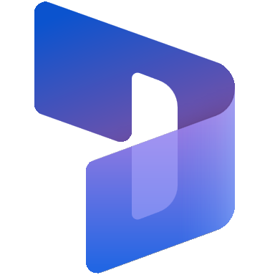





Microsoft Dynamics 365 best-in-class portfolio of intelligent business applications
2
2
2
2
Microsoft
Dynamics 365
2
2
Sales
Customer Insights
Customer Service
Supply Chain
Finance
Empower sales teams and make selling easier with AI, automation, and real-time insights built into the seller’s flow of work.
Understand your customers like never before and personalize customer journeys by using AI to deliver real-time insights.
Transform customer experiences by empowering agents to drive faster resolution and quality service using generative AI and automation.
Build an adaptable, resilient supply chain that automatically reacts to challenges using real-time visibility, agile planning, and advanced insights.
Keep pace with evolving business needs as you drive growth using finance tools for reporting, embedded analytics and AI-driven insights.
Dataverse Low Code Data Platform
Accelerate low code development with a data platform that combines common data, security and business logic.
13
Microsoft Fabric
Notes:
With Microsoft Dynamics 365, you can create the new era of AI-powered business, innovating with intelligent CRM and ERP business applications, connecting your teams, processes, and data, across your entire org, providing superior customer experiences, and creating operational agility.
Since business applications most frequently use data from multiple sources, Dynamics 365 integration with Dataverse lets you securely store and manage said data as you create your intelligent business applications. With Dynamics applications being built on Power Platform, you get built-in, extensible analytics capabilities within Microsoft Fabric that allow you to do even more with your data.
Today, we’ll be focusing on a subset of Dynamics 365 products, highlighting use cases for Supply Chain, Finance, Sales, Marketing and Service, but there are more Dynamics solutions available to solve for any of your business needs.

Slide 14

Organizational agility powered by cloud scale analytics
Microsoft Dynamics 365
Microsoft
Fabric
Unified enterprise-wide data for
a hyperconnected business
Notes:
The recent launch of Microsoft Fabric, an end-to-end analytics offering that brings together all of an organization’s data and analytics in one place, addresses that need for a constant supply of data for optimized development and modernized analytics capabilities.
We have embraced an open and governed lakehouse, establishing a unified, single source of truth by combining all analytics workloads in a secure and governed lake-first foundation. Teams can reduce the time and effort it takes to uncover impactful insights through democratized access to data, accelerating decision-making and time to value for low code app development.​
In connection with Dynamics 365, Fabric offers extensible solutions for you to be able to do even more with your data and empowers you to democratize enterprise-wide data for efficient, intelligent, and agile business application optimization.

Slide 15

Introducing Microsoft Fabric, the SaaS data platform for the era of AI
Unify data into one data estate for analytics
Build fit-for-purpose analytics and AI-powered experiences
Centralize and curate all your data in an open and governed hub that can virtualize data from Azure or AWS and enable the same copy of data to be used across workloads
Fuel your own, tailor-made AI experiences in Azure AI Studio with curated data seamlessly flowing from Microsoft Fabric
2
2
Microsoft Fabric
2
2
Unlock your data potential and transform your organization
Responsibly democratize analytics
Scale transformative analytics applications
Give everyone the ability to unlock insights in a unified platform that has industry-leading governance and compliance to help you stay in control
Gain visibility and uncover insights with responsible, self-service access to power analytics tools––accelerated by Copilot and integrated into the apps you know and trust
15
Microsoft Fabric
Notes:
Fabric is an end-to-end, human-centered analytics product that brings together all an organization’s data and analytics in one place. It brings together the best of Microsoft Power BI, Azure Synapse, and Azure Data Factory into one unified software as a service (SaaS) platform. Data engineers, data warehousing professionals, data scientists, data analysts, and business users can seamlessly collaborate within Fabric to foster a well-functioning data culture across the organization.​
With this new solution, businesses can:​
Unify all data into a single, SaaS-based estate for all data and analytics, connecting data from disparate data sources such as Azure, AWS, or GCP.​
Leverage data to build machine learning and AI models to deepen risk insight and facilitate compliance with customizable generative AI experiences using Azure AI Studio.​
Confidently and responsibly democratize access to insights and analytics across organizations in a secure and governed solution, and​
Scale transformative analytics applications and empower teams and decision-makers with self-service access to data analytics tools to uncover impactful insights easily and quickly.

Slide 16



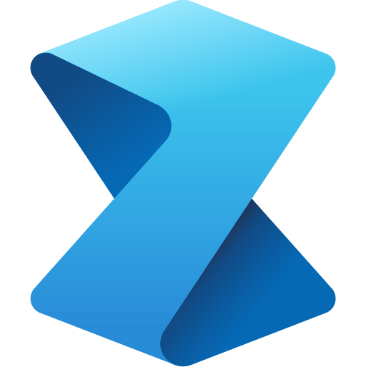

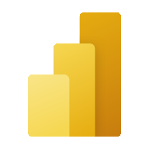




Microsoft Fabric, a unified suite of analytical experiences
Data Integration
Data Engineering
Data Warehouse
Data Science
Real Time Analytics
Business Intelligence
Applied Observability
Data Factory
Synapse
Synapse
Synapse
Synapse
Power BI
Data Activator
Powered by AI with Copilot in Microsoft Fabric
Unified data foundation
OneLake
Persistent data governance and security
Purview
16
Microsoft Fabric
Notes:
Fabric combines the best of Microsoft Power BI, Azure Synapse Analytics, and Azure Data Factory to create a single, unified software as a service (SaaS) platform with seven core workloads—each purpose-built for specific personas and specific tasks.​
Let’s explore how all these experiences empower data and business professionals alike to unlock the potential of their data and lay the foundation for the era of AI.​ Fabric empowers every team in the analytics process with the role-specific experiences they need, so data engineers, data warehousing professionals, data scientists, data analysts, and business users feel right at home. ​
You can think of Fabric as almost as Office for Data. Just like Office 365 has word for document authoring, PowerPoint for presentations, Excel for spreadsheets, etc. in Microsoft Fabric, you have 7 core workloads. ​
Data Factory provides more than 150 connectors to cloud and on-premises data sources, drag-and-drop experiences for data transformation, and the ability to orchestrate data pipelines.​
Data Engineering enables great authoring experiences for Spark, instant start with live pools, and the ability to collaborate.​
Data Science provides an end-to-end workflow for data scientists to build sophisticated AI models, collaborate easily, and train, deploy, and manage machine learning models. ​
Data Warehousing provides a converged lake house and data warehouse experience with industry-leading SQL performance on open data formats.​
Real-Time Analytics enables developers to work with data streaming in from the Internet of Things (IoT) devices, telemetry, logs, and more, and analyze massive volumes of semi-structured data with high performance and low latency.​
Power BI in Fabric provides industry-leading visualization and AI-driven analytics that enable business analysts and business users to gain insights from data. The Power BI experience is also deeply integrated into Microsoft 365, providing relevant insights where business users already work. ​
Data Activator (coming soon) provides real-time detection and monitoring of data and can trigger notifications and actions when it finds specified patterns in data—all in a no-code experience. ​
​
Copilot in Microsoft Fabric uses Azure OpenAI Service to make jobs easier. ​
​
With Copilot in Power BI, we are infusing the power of large language models into Power BI at every layer to help users get more done and create more value from their data. Using Copilot, you can simply describe the visuals and insights you’re looking for, and Copilot will do the rest. Users can create and tailor reports in seconds, generate and edit DAX calculations, create narrative summaries, and ask questions about their data, all in conversational language. With the ability to easily tailor the tone, scope, and style of narratives and add them seamlessly within reports, Power BI can also deliver data insights even more impactfully through easy-to-understand text summaries.

Slide 17

Value
Application config
Business Intelligence Config
BizApps:
Web Servers
Applications
SQL Servers
Authentication
Exchange
Data & AI :
Data Storage
Datawarehouse
ETL Tooling
Analytics Engine
Reporting
Infrastructure
Infrastructure

Slide 18
Value
Business Intelligence Config
Data & AI :
Data Storage
Datawarehouse
ETL Tooling
Analytics Engine
Reporting
Application config
BizApps:
Web Servers
Applications
SQL Servers
Authentication
Exchange
SaaS
Infrastructure

Slide 19
Value
Application config
Business Intelligence Config
BizApps:
Web Servers
Applications
SQL Servers
Authentication
Exchange
Data & AI :
Data Storage
Datawarehouse
ETL Tooling
Analytics Engine
Reporting
SaaS
SaaS

Slide 20
Microsoft Fabric capabilities

Slide 21

Microsoft Fabric
The data platform for the era of AI
Complete analytics platform
Lake centric
and open
Empower every business user
AI-powered experiences
Everything, unified
OneLake
Familiar and intuitive
Copilot accelerated
SaaS-ified
One Copy
Built into Microsoft 365
ChatGPT on your data
Secure and governed
Open at every tier
Insight to action
AI driven insights
Notes:
With the recent launch of Microsoft Fabric, we have embraced an end-to-end, unified analytics platform that brings together all the data and analytics tolls that organizations need.
As Satya put it, Fabric is “the biggest launch of a data product from Microsoft since the launch of the SQL server.”
Taking advantage of a single, easy to manage unified business model, Fabric brings together everything an organization needs for their analytics workloads. So, whether you are creating data pipelines or building machine learning models, you can use the same pool of compute to power all your workloads automatically.​
Fabric enables customers to unify their data estate by:​
First, Fabric is a complete analytics platform that works against a governed data estate across the organization. Customers can responsibly connect people and data using an open and scalable solution that gives data stewards additional control with built-in security, governance, and compliance.​
Secondly, Fabric establishes an open and lake-centric hub that helps data engineers connect and curate data from different sources—eliminating sprawl and creating custom views for everyone.​
Third, Fabric is empowering everyone in their business. Customers can innovate faster by helping every person in your organization act on insights from within Microsoft 365 apps and more.​
And finally, Fabric helps manage power AI models. Customers and accelerate analysis by developing AI models on a single foundation without data movement—reducing the time data scientists need to deliver value.​
​
Put this all together and you get a single, AI-powered platform that’s purpose-built to help customers unify their data estate, build powerful AI models, and responsibly put insights in the hands of everyone.
Additional Sources
Full Microsoft Fabric sizzle video
Learn more about Microsoft Fabric

Slide 22





Unify your analytics on a complete platform
Give your data teams all the tools they need in a unified, governed, and secure experience that reduces the cost and effort of integration
Empower data engineers, data scientists, analysts, and business users with role-specific tools in a SaaS platform built for collaboration
Gain industry-leading, end-to-end security, governance, compliance, and visibility across the unified platform
Simplify billing and reduce costs with a single pool of capacity and storage that can be used for every workload
Notes:
With Fabric, customers can use a single product with a unified experience and architecture that provides all the capabilities required for a developer to extract insights from data and present it to the business user. And by delivering the experience as software as a service (SaaS), everything is automatically integrated and optimized, and users can sign up within seconds and get real business value within minutes. With Fabric, every team in the analytics process is empowered with the role-specific experiences they need, so data engineers, data warehousing professionals, data scientists, data analysts, and business users feel right at home.
Plus with a single SaaS platform, you get end-to-end visibility, usage and adoption insights, and industry-leading governance and compliance capabilities built-in that help make sure your data is secure and accessible to those who should have access. And lastly, Fabric’s consumption model simplifies billing and reduce costs with a single pool of capacity and storage that can be used for every workload.
Let’s check out a quick demo…

Slide 23

Establish a trusted data foundation
Integrate data from anywhere into a single, multi-cloud data lake for the entire organization, and work from the same copy of data across analytics engines
Easily connect to data across clouds using “Shortcuts” to virtualize data in OneLake without having to move or duplicate the data
Create, integrate, manage, and operate data lakes standardized on Delta Parquet format; the same open data format as Azure Databricks
Intuitively organize your data in Microsoft Fabric’s data lake––OneLake––for central data discovery, sharing, governance, and compliance
Notes:
Fabric’s unified, multi-cloud data lake, OneLake, is automatically wired into every Fabric workload and designed to help you simplify data management and reduce data duplication. OneLake shortcuts allow you to virtualize data into OneLake from across clouds, accounts, and domains, with sources like Azure Data Lake Storage Gen2 and Amazon S3—all without duplication, movement, or changes to metadata or ownership. Once enabled in OneLake, you can use domains and workspaces to organize your data into a logical data mesh and empower everyone to search across this mesh using an intuitive, personalized data hub. OneLake’s open data format means you only need to load the data into the lake once and you can use the single copy across every Fabric workload and engine, minimizing data duplication and sprawl.

Slide 24

Empower every business user
Empower everyone to uncover insights with the data they need, easy-to-use tools, and visuals embedded in the Microsoft 365 apps they use everyday
Quickly go from data in a lakehouse to insights
in the hands of your business users
Save time for analysts and provide up-to-date insights with Direct Lake mode, a blazing fast,
real-time connection to your data in OneLake
Foster a data-driven culture by seamlessly and securely embedded insights into Teams, Excel, PowerPoint, Outlook, and more with native integration
Notes:
Microsoft Fabric was built to help foster a data culture—enabling anyone to quickly go from data sitting in a lake to stunning Power BI visuals embedded in a Microsoft 365 app. You can more easily empower your business with capabilities like Real-Time Intelligence, which can empower your teams with real-time insights with incredibly low latency. In addition, Direct Lake mode in Power BI allows users to create a real-time connection from your Power BI reports to your data in OneLake. This direct integration between Power BI and OneLake helps ensure only one copy of the data is ever created, helping you promote reuse of the best data for business users and avoid data fragmentation. This data can then easily and securely flow to the Microsoft 365 applications people use every day like Microsoft Teams, Outlook, PowerPoint, Excel and more to improve decision-making and drive impact.

Slide 25

Fuel your AI innovation
Adopt a data platform that’s infused
with AI at every layer to help you get
more done, faster.
Use conversational language with Copilot
in Fabric to create dataflows and pipelines,
write SQL statements, or even build machine learning models
Simply describe what you need—including reports, summaries, and calculations—or ask a question, and Copilot does the rest
Build an AI skill to ask questions about your data in an easy-to-use conversational experience—without any setup or configuration.
Use LangChain and Semantic Kernel to develop and scale custom generative AI models—right from your Fabric Notebook
Notes:
By infusing generative AI into every layer of Microsoft Fabric, we can empower your data professionals to employ its benefits, in the right context and in the right scenario to get more done, faster.
Copilot in Fabric was designed to help every user unlock the full potential of their data by assisting data professionals be more productive and business users to explore their data more easily. With Copilot in Fabric, you can use conversational language to create dataflows, generate code and entire functions, build machine learning models, or visualize results. You can also build an AI skill; an innovative experience designed to provide any user with a conversational Q&A experience about their data. AI skills allows you to simply select the data source in Fabric you want to explore and immediately start asking questions about your data—even without any configuration.
Let’s check out a video

Slide 26


Fuel your journey to AI innovation by getting your data AI ready
Build generative AI experiences
on top of your data
3
Prepare data for
AI innovation
Establish a central repository for all data
2
Enhance the breadth and depth of data-driven experiences by creating
an AI solution
1
Improve the quality of your data, to ensure it is complete, accurate, and governed
Integrate disparate data sources into a unified data platform and data lake
OneLake
Microsoft Fabric data experiences
Azure AI Studio
Notes:
Microsoft Fabric makes data accessible to everyone, leveraging AI to evolve data to deliver actionable insights across all levels of technical expertise. These are the steps you’ll need to take to get your data AI-ready.
​
Establish a central repository for all data ​
Most organizations’ analytics systems are a labyrinth of specialized and disconnected services. And as we all know, garbage in is garbage out. As businesses build more modern data capabilities, it’s increasingly important for all disparate sources of data be integrated into a unified source. OneLake, incorporated into Fabric, functions as a centralized data lake, consolidating all your data into a single, accessible location for comprehensive data management. Plus, it’s backed by built-in security and governance, ensuring the protection of all your data. ​
​
Prepare data for AI integration​
For AI/ML models to be as accurate as possible, they need to be built with clean data and in a semi-structured way. Fabric is the perfect platform to prepare your data before building custom AI experiences. With data experiences like Data Integration, Data Engineering, and Data Warehouse built into Fabric’s SaaS-based data platform, it’s easy to ensure all your data is complete, accurate, and governed. ​
​
It’s important to note that training an accurate AI model takes a tremendous amount of data. To cost-effectively expand your data coverage, consider utilizing tools such as the Power Platform to facilitate diverse data acquisition methods and gather additional inputs from various systems to create a comprehensive dataset.​
​
Build generative AI experiences on top of the data​
Once you have a cleaned, robust dataset, it’s time to start building generative AI experiences on top of your data. These first two steps are critical to get right before building generative AI experiences because of two-fold:​
​
Establishing a Central Data Repository – The creation of a centralized data repository is important for data consistency and, by extension, data quality. A unified data source paves the way for dependable and high-quality data, which is the bedrock for any generative AI.​
Preparing Data for AI Integration – The quality of your generative AI outputs is linked to the quality of your inputs. The meticulous process of preparing the data is paramount in shaping the capabilities and reliability of your generative AI models.​

Slide 27

Microsoft Fabric: OneLake, sophisticated AI, democratized BI
Data Integration + Warehousing
Data
Science
Business Intelligence
Integrate data from Dataverse and various on-prem, hybrid cloud, or 3rd party sources.
Quickly train, deploy, and manage ML models at scale to unlock deeper insights.
Uncover powerful insights with intelligent visuals and translate those insights into impact.
1
2
3
4
5
Dataverse
Microsoft
Fabric
Data Transformation & Enrichment
Real-Time Analytics & Observability
Dataverse
Microsoft
Dynamics 365
Native Integration.
No ETL, No Copy
OneLake
Cleanse, structure, and aggregate integrated data to prepare it for analysis.
Perform analysis on large volumes of streaming data, monitor changes from that data in real-time, and automate workflow based on those changes.
Notes:
For data engineers, Microsoft Fabric enables data integration into a single source of truth, data transformation, data enrichment and data validation.​​ They play a crucial role in configuring and managing this data integration, ensuring that data from various sources—on prem, hybrid cloud, and 3rd party sources are seamlessly integrated in One Lake. And since Dataverse is natively integrated, you can integrate data from Dataverse with No ETL and No Copy.
[Optional] In the data warehousing phase, data engineers can scale compute and storage independently and democratize the data estate while guaranteeing fast performance on complex queries enabling millions of predictions in just seconds.
The next step is data transformation and enrichment…data engineers cleanse, structure, and analyze integrated data. They then use additional 3rd party data to enrich that dataset. This step is pivotal in turning raw data into meaningful insights.
In stage 3, with the AI and Machine Learning capabilities in Fabric, Data scientists can build and train machine learning models for predictive analytics.
In stage 4, the real-time analytics capabilities found in Fabric allow analysts to turn insight into action in real time. They can Explore data and perform real-time analysis on large
volumes of data streaming from applications, websites, IoT devices, and more. And with a system of detection that monitors your changes in your analytics, they can drive timely actions across the organization with signals and triggers that integrate into a variety of systems.
Lastly, data analysts can utilize the business intelligence capabilities in Fabric to uncover powerful insights with intelligent visuals and translate those insights into impact by embedding visualizations in the systems where business users work.
Now, let’s look at how each of these analytical experiences apply to our hyperconnected retail experience scenario.
----
SECOND TALK TRACK BELOW: For retail-specific scenario
For data engineers, Microsoft Fabric enables data integration into a single source of truth, data transformation, data enrichment and data validation.​​ They play a crucial role in configuring and managing this data integration, ensuring that data from various sources—on prem, hybrid cloud, and 3rd party sources are seamlessly integrated in One Lake. And since Dataverse is natively integrated, you can integrate data from Dataverse with No ETL and No Copy.
[Optional] In the data warehousing phase, data engineers can scale compute and storage independently and democratize the data estate while guaranteeing fast performance on complex queries enabling millions of predictions in just seconds.
The next step is data transformation and enrichment…data engineers cleanse, structure, and analyze integrated data. They then use additional 3rd party data to enrich that dataset. This step is pivotal in turning raw data into meaningful insights.
In stage 3, with the AI and Machine Learning capabilities in Fabric, Data scientists can build and train machine learning models for predictive analytics.
In stage 4, the real-time analytics capabilities found in Fabric allow analysts to turn insight into action in real time. They can Explore data and perform real-time analysis on large
volumes of data streaming from applications, websites, IoT devices, and more. And with a system of detection that monitors your changes in your analytics, they can drive timely actions across the organization with signals and triggers that integrate into a variety of systems.
Lastly, data analysts can utilize the business intelligence capabilities in Fabric to uncover powerful insights with intelligent visuals and translate those insights into impact by embedding visualizations in the systems where business users work.
Now, let’s look at how each of these analytical experiences apply to our hyperconnected retail experience scenario.

Slide 28

A hyperconnected retail experience
The Dynamics 365 Portfolio, powered by Fabric
Supply Chain & Finance
Build a resilient and unified supply chain and maximize financial visibility and profitability, proactively preparing and adjusting to avoid disruptions
Sales & Customer Insights
Close more deals and personalize customer offerings with connected, AI-assisted experiences and recommendations
Customer & Field Service
Personalize the service experience and create lasting connections with AI-assisted solutions, quickly solving customers’ needs and delivering omnichannel service
Notes:
Imagine a single experience that leverages not only all of the Fabric analytical experiences, but also the full breadth of the Dynamics 365 suite of intelligent business applications. You can also leverage Copilot in Fabric as well, which combines advanced generative AI with your data to help teams uncover and share insights faster.
Business decision makers can leverage a unified data estate and data experiences to create hyperconnected retail business with increased agility and efficiency. This intelligent, digital business:
Increases visibility, productivity, and collaboration across teams
Operates with a resilient supply chain for maximized profitability
Understands customer behavior and preferences with prioritized product selection
Closes more deals with AI-assisted, personalized customer offerings and
Creates superior customer experiences, solving customers’ needs faster with an omnichannel service offering
From improving inventory management by unifying and analyzing data across store location, business managers can use Supply Chain solutions to create improved, end-to-end visibility. They can also take advantage of Finance solutions to collect financial data from across the organization and view it in OneLake, building models that help forecast financial projections, developing budget reporting templates and setting up alerts for any budget changes.
Marketing managers can create more effective marketing campaigns, learning from browsed products and items in cart to identify potential customers and remarket to them with relevant products, and Sales managers can build reports highlighting near real-time insights that drive higher conversion rates.
Similarly, customer success teams can use Customer Service to drive more meaningful engagement with customers, using AI-assisted solutions to help solve customers’ needs and create lasting customer connections.

Slide 29
The art of the possible

Slide 30
Demo

Slide 31




CPG scenario: Build a resilient supply chain and optimize profitability across the value chain
Supply Chain
Enhance inventory planning and identify and prioritize products based on trends, addressing stock levels before inventory shortages hit
Streamline fulfillment and distribution, making it easier to identify over- and under-used resources and assess distribution center efficiency
Finance
Connect sales, inventory, pipeline, and cost data from different channels to uncover patterns that optimize the profit and revenue from sales
Build AI and ML models that can be used across different datasets to drive more efficient work, determining project profitability and sharing it with interactive visuals
Notes:
Together, Microsoft Fabric and Dynamics 365 can revolutionize how businesses operate, with in-product Fabric capabilities as well as extensible solutions to take your data even further. Let’s walk through a hypothetical CPG scenario, examining how these solutions shape the future of business and highlighting the ways you can further your data and analytics capabilities with Microsoft Fabric.
Setting the foundation for any organization’s success, business decision makers at a global CPG enterprise leverage Dynamics 365 Supply Chain to create a smart, connected factory and automate and optimize fulfillment.
Using Fabric, Supply chain managers can unify sales and production data, identifying and prioritizing products based on trends, and planning for and mitigating potential disruptions by addressing stock levels before inventory shortages strike.
This enhanced inventory planning works in tandem with the ability to streamline fulfillment and distribution, identifying over- and under-used resources using production pick rates to predict whether to flex up or down, therefore assessing and optimizing distribution center efficiency.
Not only can the CSCO gain increased visibility of their value chain while mitigating risk, but the CFO, with intelligent business applications like Dynamics 365 Finance, can empower financial managers to connect sales, inventory, pipeline, and cost data from all channels to uncover patterns that optimize the profit and revenue from sales, building dashboards that explain trends.
Similarly, financial managers can leverage Fabric and input Finance data, preparing it to use and build AI and ML models. These models can be used across different datasets, driving more efficient work across departments, and determining project profitability with interactive visuals highlighting what-if scenarios, project correlations and range slicers.

Slide 32



CPG scenario: Better understand your customers and close more deals
Customer Insights
Collect real-time, cross-channel data and analyze product, region and segment level performance to develop better targeted ads
Track brand awareness campaign effectiveness at the individual store level by collecting and analyzing store and behavioral data
Sales
Increase deal size via market basket analysis, compiling data to discover products frequently purchased together and identify cross-sell and up-sell opportunities
Tailor sales efforts to local markets, tracking individual store activity by ingesting real-time sensor data and using advanced analytics to understand sales conversion
Notes:
With this digital and intelligent operational foundation in place, marketing teams can take advantage of Dynamics 365 Customer Insights & Sales solutions.
Using Fabric with their existing Dynamics and third-party data, product marketing managers can collect real-time data like impressions, click-through rates and video ad view rates, analyzing product, region and segment level performance and then using those insights to develop more accurate targeted ads.
Marketing managers can achieve a deeper understanding of their brand, as well as the efficacy of their campaigns, tracking brand awareness initiatives at the individual store level by collecting and analyzing store and behavioral data, improving their understanding of their customers and better catering to their needs.
Using Dynamics 365 Sales data, sales managers can identify cross- and up-sell opportunities and increase deal size via market basket analysis, compiling data to discover products frequently purchased together.
Like the marketing teams who can analyze campaign data at a micro level, sales managers can increase localization and tailor their efforts to local markets, tracking individual store activity, IoT and telemetric data and using advanced analytics to then understand sales conversion at the individual store level.
///
As customers progress through the customer journey, this CPG organization can create long-lasting customer experiences and connections using Dynamics 365 Customer Service.
With existing data and Microsoft Fabric, customer success managers can improve employee training and product knowledge, providing teams with easy-to-understand reports that increase productivity across channels and empower teams to provide better service to customers in need while driving higher conversion rates.
Customer service teams can personalize customer experiences with generative AI-assisted technology and create a 360-degree view of each customer based on data shared with the organization, including social, bio information from purchase, and location. This creates a tailored, omnichannel experience that meets customers where they are and facilitates longer-lasting connections.
In this scenario, we’ve seen modernization and digital intelligence implemented, in partnership with Microsoft Fabric and Dynamics 365, across the stages of asset lifecycle and the customer journey. With increased access to insights and analytics, supply chain, finance, marketing, sales, and customer success teams are able to gain a better understanding of their day-to-day operations, becoming more agile and efficient, increasing productivity and better positioned to delight customers and track against KPIs.

Slide 33



CPG scenario: Increase employee efficiency and create long-lasting customer experiences
Customer Service
Improve employee training & product knowledge by providing easy-to-understand reports and real-time insights that increase productivity across channels
Personalize customer experiences through a 360-degree view, creating a tailored and AI-assisted, omnichannel experience
Notes:
As customers progress through the customer journey, this CPG organization can create long-lasting customer experiences and connections using Dynamics 365 Customer Service.
With existing data and Microsoft Fabric, customer success managers can improve employee training and product knowledge, providing teams with easy-to-understand reports that increase productivity across channels and empower teams to provide better service to customers in need while driving higher conversion rates.
Customer service teams can personalize customer experiences with generative AI-assisted technology and create a 360-degree view of each customer based on data shared with the organization, including social, bio information from purchase, and location. This creates a tailored, omnichannel experience that meets customers where they are and facilitates longer-lasting connections.
In this scenario, we’ve seen modernization and digital intelligence implemented, in partnership with Microsoft Fabric and Dynamics 365, across the stages of asset lifecycle and the customer journey. With increased access to insights and analytics, supply chain, finance, marketing, sales, and customer success teams are able to gain a better understanding of their day-to-day operations, becoming more agile and efficient, increasing productivity and better positioned to delight customers and track against KPIs.

Slide 34
Integrating Fabric and Dynamics 365

Slide 35

Seamless integration of intelligent business applications with unified analytics
Dataverse
Microsoft Fabric
Dynamics 365
The intelligent, scalable, low-code platform that manages data and business logic across Microsoft Dynamics 365 and Microsoft Power Platform.
The one-stop-shop for data integration, data engineering, real-time analytics, data science, and business intelligence across all your organizational data.
The portfolio of intelligent business applications that delivers superior operational efficiency and enables businesses to become more agile.
Native integration
35
Microsoft Fabric
Notes:
Microsoft now enables business application optimization powered by cloud scale analytics with Microsoft Fabric and Dynamics 365 integrated through Microsoft Dataverse. The native integration between the intelligent business applications portfolio, Dataverse, and Microsoft Fabric enables you to easily use data already in Dataverse and/or connect the data in Fabric to your business applications, ERP, and CRM systems.
Plus, working conversationally with your data, simply describe the insights you need or ask a question about your data and Copilot in Fabric will analyze and pull the right data into a report.
[Alt: you can seamlessly include conversational AI into your business applications with Copilot in Microsoft Fabric.]

Slide 36

Dataverse makes it easy to connect Dynamics 365 to Microsoft Fabric
Microsoft Dataverse
Microsoft Dynamics 365
No Copy. No ETL.
Direct Connection via Dataverse
Insights democratized to all low code apps using Fabrics seven core workloads
Makers informed by insights improves quality of applications
Data is governed
Microsoft Fabric
36
Microsoft Fabric
Notes:
With a few clicks you can choose data and launch directly in Fabric
There is no data copy or ETL schedules to manage – the system does all the work for configuration and data movement
The system generates an Azure Synapse lakehouse, SQL endpoint and default Power BI dataset with your data, saving hours and days of work.
Insights democratized to all low-code apps using core Fabric workloads
Open and governed access controls so data is protected
With Fabric’s Back Arrow capability, you can easily turn every table into a native Data Lake table. This empowers users to drive actions in first and third-party applications, further extending processes with OneLake insights, all within reach of a Power applications user.

Slide 37
Dynamics 365 and Microsoft Fabric: Better Together
Microsoft Dataverse
Microsoft Dynamics 365
Drive efficiencies and empower teams to innovate
Native integration
Create a hyperconnected business as you reduce operational complexity, democratize organizational data, and extract more value from your data.
Easy direct data integration with Dataverse means you can automatically make all your Dynamics 365 and Power Platform data available for analysis in Microsoft Fabric.
Turn insights into action
Leverage real-time, actionable insights through low code applications for efficient and effective decision-making to transform your business.
Microsoft Fabric
37
Microsoft Fabric
Notes:
From native integration to real-time insights democratized to data professionals and business users – Dynamics 365 and Microsoft Fabric give new meaning to creating exceptional experiences that drive business value.

Slide 38
Getting Started

Slide 39
Get started today
Set up your free Microsoft Fabric trial
https://aka.ms/try-fabric
Learn more about Microsoft Dynamics 365
https://dynamics.microsoft.com
Get the latest Microsoft Fabric news
https://info.microsoft.com/fabric-interest
Read the implementation guide
https://aka.ms/Getting-Started-eBook

Slide 40


Thank you

